Slide 1
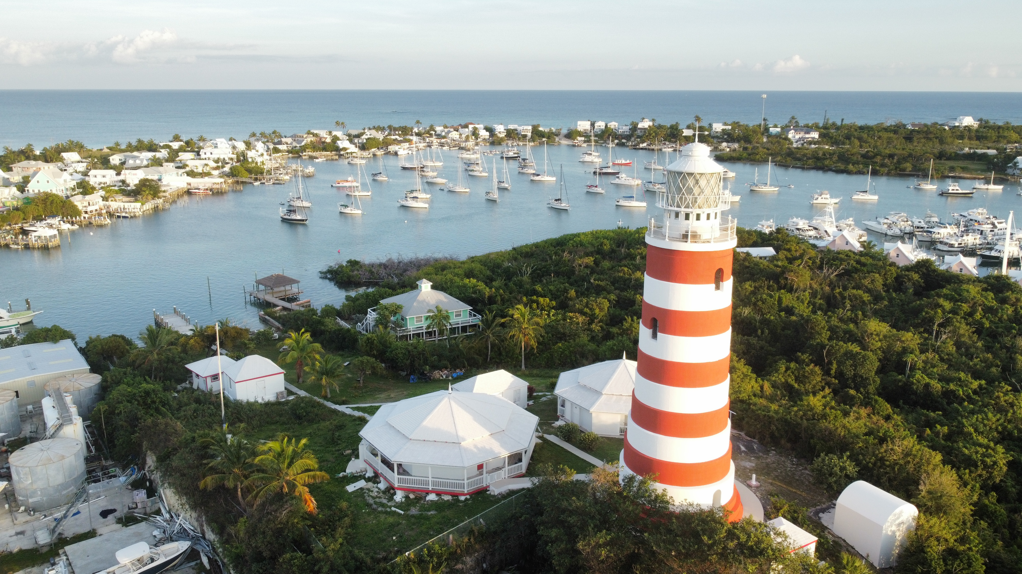

Sea Base
Bahamas
2024 Programs
Information Session

Slide 2
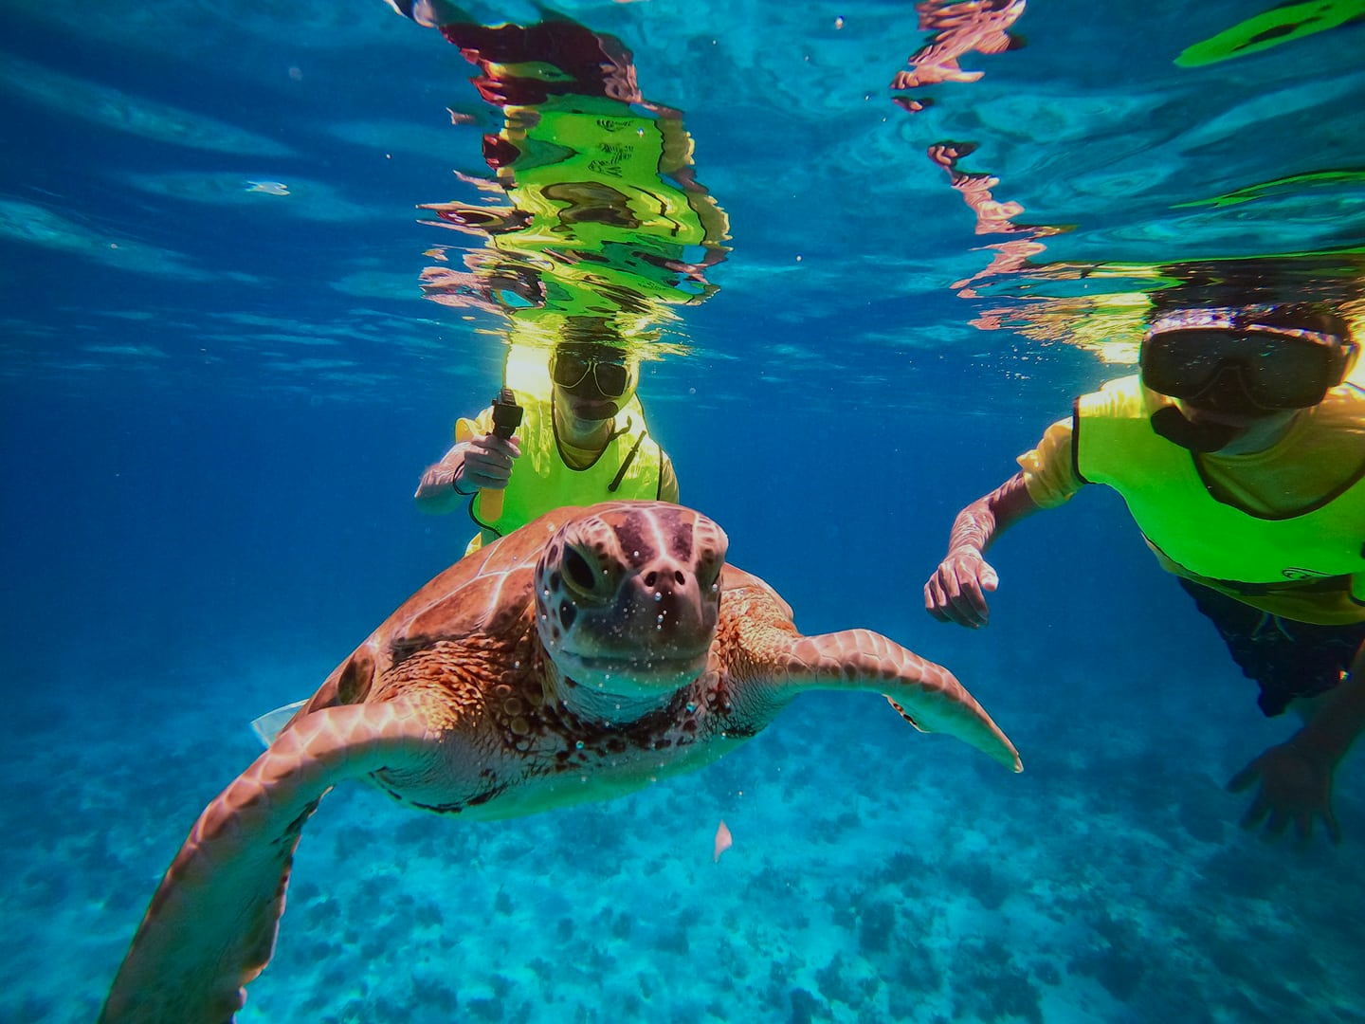
Bahamas Programs
Participant Guides
Bahamas Adventure 6-8 (6 days/5 nights)
  Crew Size: 6-8 participants
  BA 071024 A
Bahamas Adventure 10-12 (6 days/5 nights)
  Crew Size: 10-12 participants
  BS 071024 A
Bahamas Tall Ship (6 days/5 nights)
  Crew Size: 18-20 participants
  BT 071024 A

Slide 3
Eligibility
General Eligibility
Adult Leader Eligibility
Registered Member of BSA
BSA Swim Classification-Swimmer
13 years of age
Medically Approved to Participate
  (BSA AHMR)
Able to Obtain a Passport
Registered Member of BSA
BSA Swim Classification-Swimmer
Medically Approved to Participate
Completed Training Certificates
  YPT, Safe Swim Defense, Safety Afloat, Haz. Weather, and one adult must have WFA and one adult must be CPR/AED certified.
21 years of age or older
Ratios of males to females and youth to adults

Slide 4
Paperwork
At a Glance-By Crew
At a Glance-For Adults age 21+
Crew Roster (90 days prior to arrival)
Pre-Event Medical Screening
  Should be filled out just prior to departing for Sea Base.
Vessel Liability Waiver (first 2 spots left blank)
  Have parents sign for youth prior to departing
Unit Swim Classification
BSA AHMR (BSA Medical)
  Must be 2019 version
  Good for one year
  Copies of Insurance Cards (Front & Back)
Passport
Bahamas Consent Form for youth who are traveling without a parent
At least one adult leader
  CPR/AED
  Wilderness First Aid or greater certification (course must have in-person section)
Each adult leader
  Youth Protection Certificate
  Safe Swim Defense Certificate
  Safety Afloat Certificate
  Hazardous Weather Certificate

Slide 5
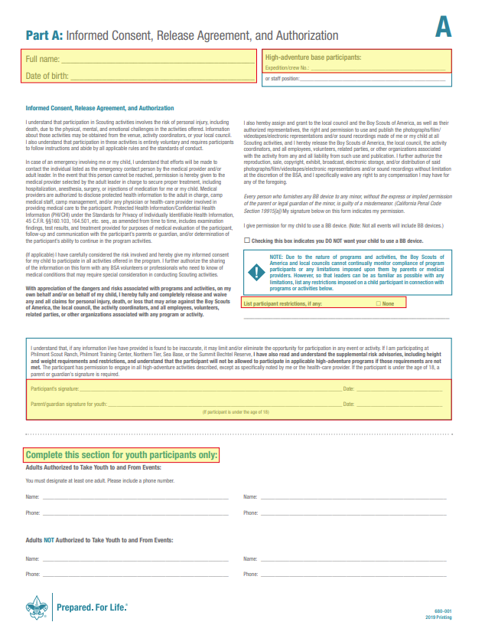
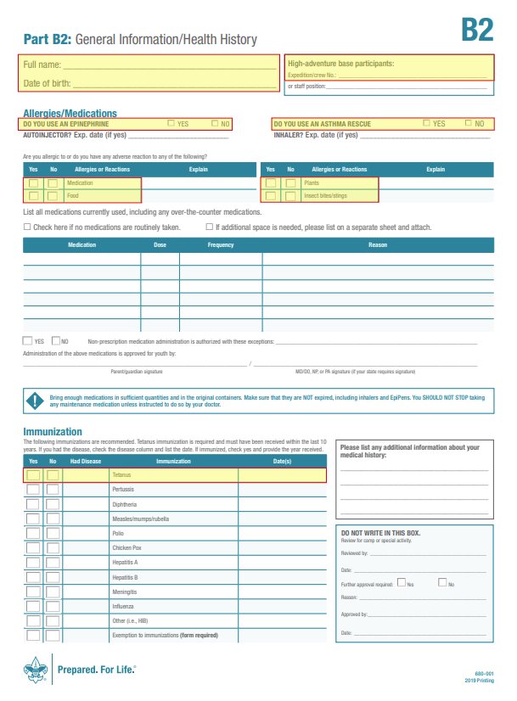
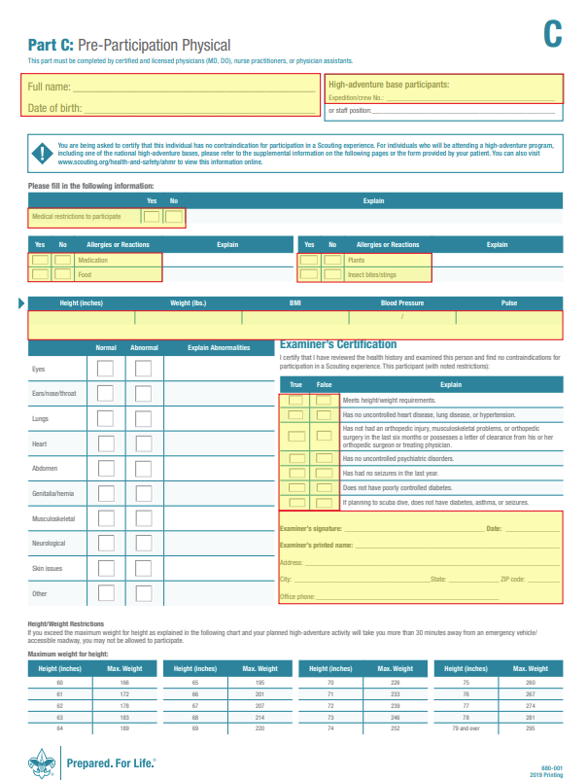
Common mistakes on the medical

Slide 6
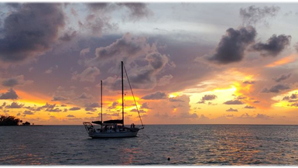
Bahamas Adventures Overview
6 day/5 night adventure (For example – Arrive to the dock ready to board your boat on Sunday, depart from the dock on Friday)
Arrival day: Arrive between 1-4 pm at the Conch Inn & Marina in Marsh Harbour, Bahamas
    Crews typically fly into Marsh Harbour Airport (Leonard M. Thompson International Airport). From the airport, crews should take the first available taxi to Conch Inn & Marina. Anticipate $5-10 per person per trip.
    Conch Inn & Marina: 700 Bay St. Marsh Harbour, Bahamas
  Check-in: Paperwork check and arrival briefing. After boarding, there will be an orientation and a swim/snorkel review. Your first night will be at anchor in a protected anchorage.
Days 2-5: Enjoying your adventure living and working aboard a sailing vessel, snorkeling the reefs of the Abaco Islands, learning to sail, and fishing along the way. You will have an opportunity to visit the outer Cays, which each have something unique to offer.
Departure day: Crew must be ready to depart from the dock as early as necessary but no later than 11:00 am.
Post- Adventure: If you earned patches while you were at Sea Base Bahamas, i.e. Captain’s Club or BSA Snorkel, you can purchase earned patches from our Ship Store online at store.bsaseabase.org

Slide 7
Recommended Prep
Prepared: Sea Base Adventures are aquatics based and require participants to be fit, competent swimmers and hikers. It is recommended that your unit, in consultation with your local council BSA Aquatics Director or qualified swim instructor, develops a crew training regimen that includes both swimming and snorkeling. An adequate plan includes:
  BSA Swim Test. Become strong, competent swimmers (monthly swimming sessions are recommended beginning 6 months prior to arrival).
  Snorkel. Practice clearing a mask and snorkel. (Snorkel BSA)
  Practice nautical map and compass navigation.
  Seek local instruction regarding the use of VHF marine radios, safety flares, man overboard procedures and drill potential emergency situations.
  Adult leaders play an important role in ensuring safety aboard and in the water. Adults must understand Safe Swim Defense Training and Safety Afloat Training Guidelines and be prepared to assist in emergency situations.
  Review Guide to High Adventure Sailing
  Watch US Sailing Video: Parts of a Boat
  Watch US Sailing Video: Parts of a Rig
  Watch US Sailing Video: Points of Sail
  Reminder: no previous sailing experience is required, but these tools will help your crew make the most of their time at sea!

Slide 8
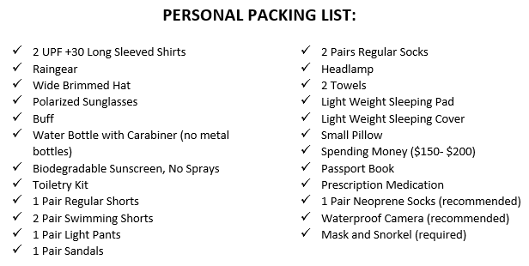
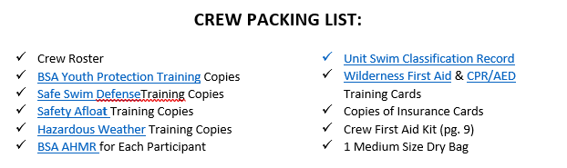
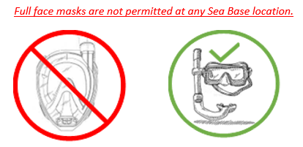
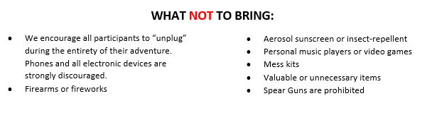
Packing List

Slide 9
Frequently Asked Questions
What kind of shoes can we wear on the boat?
The boat shoe policy is “no shoes”. You will need shoes for walking through settlements and on beaches. It does not need to be closed toe but more like a Teva or Croc. Tennis shoes will not work because they do not dry out from the salt water and collect sand.
Will we get a shower on this trip?
No, you will not have a “shower” as you know it. There will be opportunities to take Joy baths during the week. This is done by lathering up with Joy and jumping in the sea for a rinse. The boats can provide a freshwater rinse at the end.
What is a Crew Chief?
The crew chief will work directly under the Captain or First Mate and will oversee the crew, including the adult leaders. The Chief will organize cooking, chores, and oversee all shoreside activities. It is a role in leadership and should not be taken lightly. This must be a youth and should be someone with leadership experience. The Crew Chief should be decided before arriving at Bahamas Sea Base.
Do I need raingear?
Yes, everyone should have a rain jacket regardless of the time of year.
Can I bring luggage with wheels?
No, the boats cannot accommodate wheeled bags, they should only be duffle type bags.

Slide 10
Frequently Asked Questions, cont.
Is there storage in the Bahamas?
No, there is not any type of storage, everything will go aboard your vessel with you
Will we stay in a marina?
No, you will only be at anchor or on a mooring ball.
Can the Bahamas accommodate food allergies?
We are limited as to what we can get but will do our best to work with individuals. Please keep this in mind when making special requests.
Do I need cash?
Yes, the cab ride to and from the airport will only except cash. When visiting settlements, there will be a few shops, ice cream, and restaurants to try some of the local fare. Although these places may accept credit cards, there is a minimum, possibly an international fee, and the credit card machine is often down. It’s difficult to get cash once you arrive, so best to bring a little extra.
Can I bring my own fishing gear?
No, although fishing is a part of this adventure, it is somewhat limited on a sailboat. The vessel will have all the gear that you will need.

