Slide 1

Florida Fishing Adventure

Slide 2

Brief History of Sea Base
The Sea Base began in the early 1970's as a local program in the Florida Keys called the Florida Gateway to High Adventure under the guidance of Sam Wampler, a professional Scouter from the South Florida Council. It offered primarily sailing programs using local marinas and chartered boats sailing to the Bahamas and back. As the idea caught on and grew, it joined the high adventure offerings of the National Council of the BSA along with Philmont Scout Ranch and the Northern Tier High Adventure Base.
In 1979, the Sea Base acquired a permanent facility on Lower Matecumbe Key. It opened for Scouts in 1980 and renamed the Florida National High Adventure Sea Base. As the popularity of this program grew, SCUBA diving was added and in 1984 the BSA received the gift of Big Munson Island from Homer Formby. This undeveloped island offered tremendous program potential as an outpost for primitive camping, Robinson Crusoe style. In 1999, the building of the Brinton Environmental Center began and opened its doors in 2001. Originally starting with the Out Island and Keys Adventure programs, later adding the Florida Fishing Adventure, Order of the Arrow Ocean Adventure, Marine STEM Adventure and a land-based coral nursery.

Slide 3
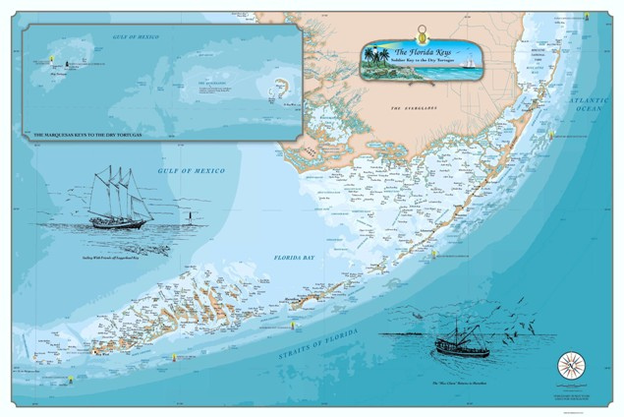
The Florida Keys
Brinton Environmental Center
Mile Marker 23.8
Florida Sea Base
Mile Marker 73.8
Your adventure will take place at the Brinton Environmental Center

Slide 4
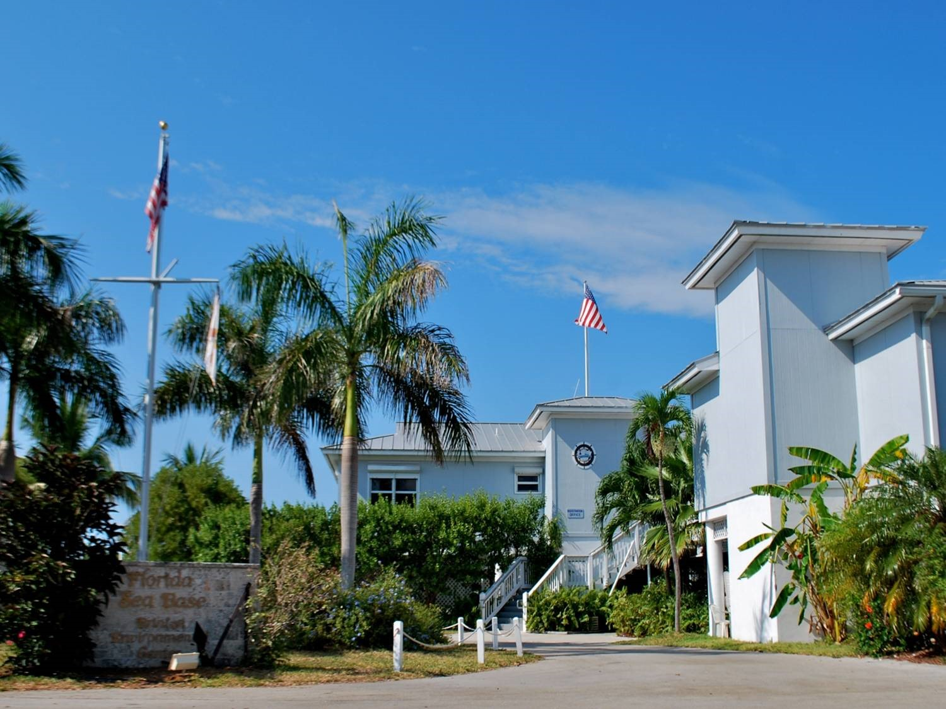
Arrival & Registration
Arrive at the Brinton Environmental Center between 1 – 3 PM
Check in and review documents
Meet your Fishing Adventure Mate
Check into Dorms
Issue Snorkel Gear
BSA Swim Review
Snorkel Lesson
Opening Shindig

Slide 5
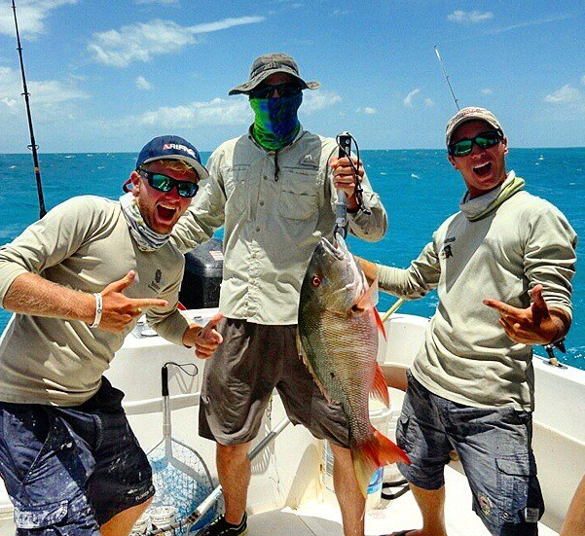
Weekly Schedule
The Fishing Adventure Program is a fish and fun-filled adventure. It is up to your crew to decide what kind of species to target each day and which fishing techniques to explore, based on the Captain and Mate’s expertise. Weather and tides are large factors in the week’s fishing plans. Crews need to be prepared to be flexible in daily fishing plans. Sea Base cannot control the winds or weather. The following is an example of a Fishing Adventure week:
Day One: Arrival Day: Check in, swim & snorkel review, opening shindig
Day Two: Reef Day: Target Species: Snapper; Mackerel; Grouper. Load boat and leave after breakfast for a full day of reef fishing, returning to base to clean the boat and the fish, all before dinner.
Day Three: Offshore Day: Target Species: Mahi-Mahi; Tuna; Wahoo. Load boat and leave after breakfast for a full day off-shore trolling or drift-fishing, returning to base to clean the boat and the fish, all before dinner.

Slide 6
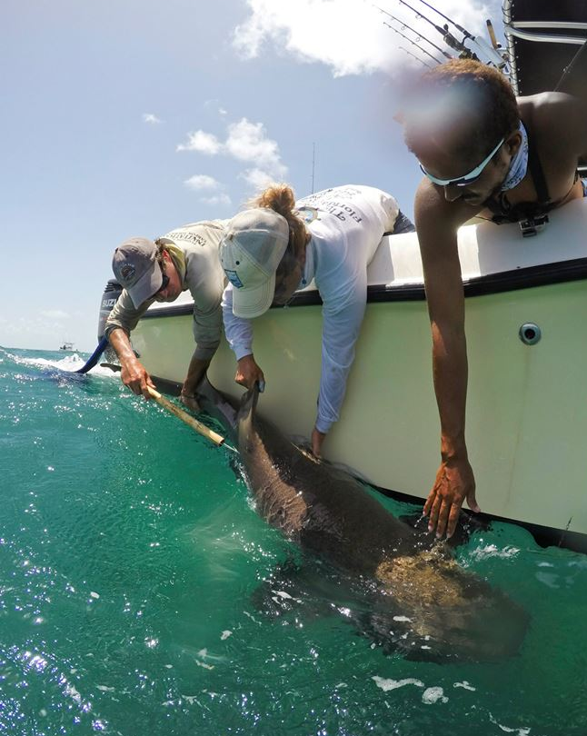
Weekly Schedule (cont.)
Day Four: Backcountry Day: Target Species: Snapper; Mackerel; Grouper; Sharks, Barracuda, etc. Load boat and leave after breakfast for a full day of fishing the watery wilderness of uninhabited, mangrove-lined keys of the backcountry, returning to base to clean the boat and the fish, all before dinner.
Day Five: Snorkel Day: Leave on a boat after breakfast to go snorkeling for half a day at Looe Key, weather permitting. After, your crew and mate will venture down to Key West to explore, have dinner, and see the Sunset Festival at Mallory Square.
Day Six: Shark Fishing Day: Target Species: Sharks! Load boat and leave after breakfast for a full day of tugging on aggressive predators. Return to base to clean the boat and get ready for your Luau and closing ceremony.
Day Seven: Departure.

Slide 7
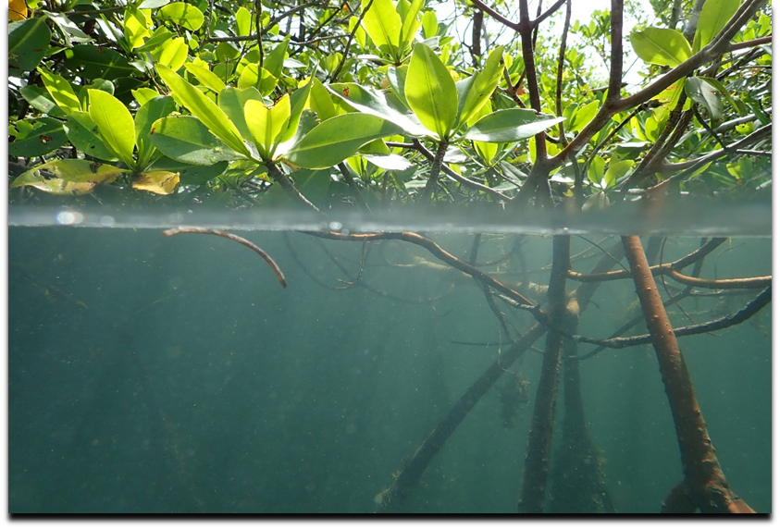
Required Paperwork
Sea Base Check-In Documents
Crew Roster
BSA Health and Medical Records
Unit Swim Classification Record
Adult Leader Training Certificates
WFA & CPR/AED Training Certificate(s)
Pre-Event Medical Screening Checklist
All copies of forms should be placed in a folder or notebook and submitted upon arrival during check in. Please refrain from using plastic sleeves to ensure a timely check in process.

Slide 8
Eligibility Requirements
Crew Rosters completed 90 days prior to arrival
All participants must be 12 years of age or older
Registered member of the BSA
All adult leaders must complete the following adult leader trainings: BSA Safe Swim Defense, BSA Safety Afloat, BSA Hazardous Weather, BSA Youth Protection. Please provide copies of certificates upon arrival
At least one adult leader per crew must have Wilderness First Aid and CPR/AED certifications. Please provide copies of certifications upon arrival
All participants must pass the BSA Swim Test prior to arrival as a Swimmer, evidenced by the Unit Swim Classification Record. All participants must complete the Sea Base Swim Review upon arrival. Non-swimmers will be sent home at their own expense.
Medically Approved for Participation, evidenced by the BSA Annual Health and Medical Record & meets Sea Base Risk Advisory Medical Requirements
Pre-Event Medical Screening Checklist per crew
No participant can exceed 295lbs as evidenced by the medical form. No exceptions will be made. Participants exceeding 295lbs will be sent home at their own expense

Slide 9
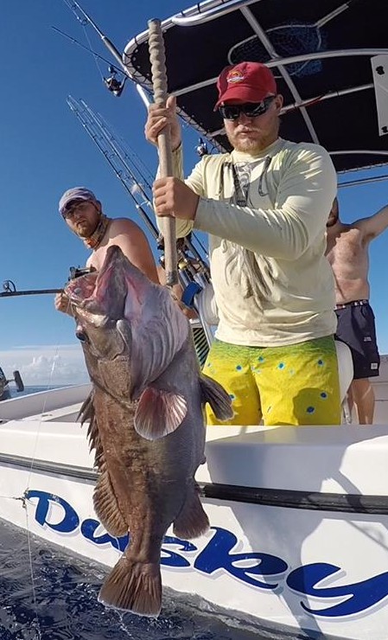
Fishing License
Fishing Adventure participants 16 years of age and older must purchase a 7-day saltwater fishing license.
Your license must begin the second day of your adventure and can be purchased at gooutdoorsflorida.com. Sea Base does not sell fishing licenses.
Units arriving between August 6 and March 31 can also purchase a lobster tag.
We do not participate in Lobster Mini Season the last Wednesday/Thursday of July.

Slide 10
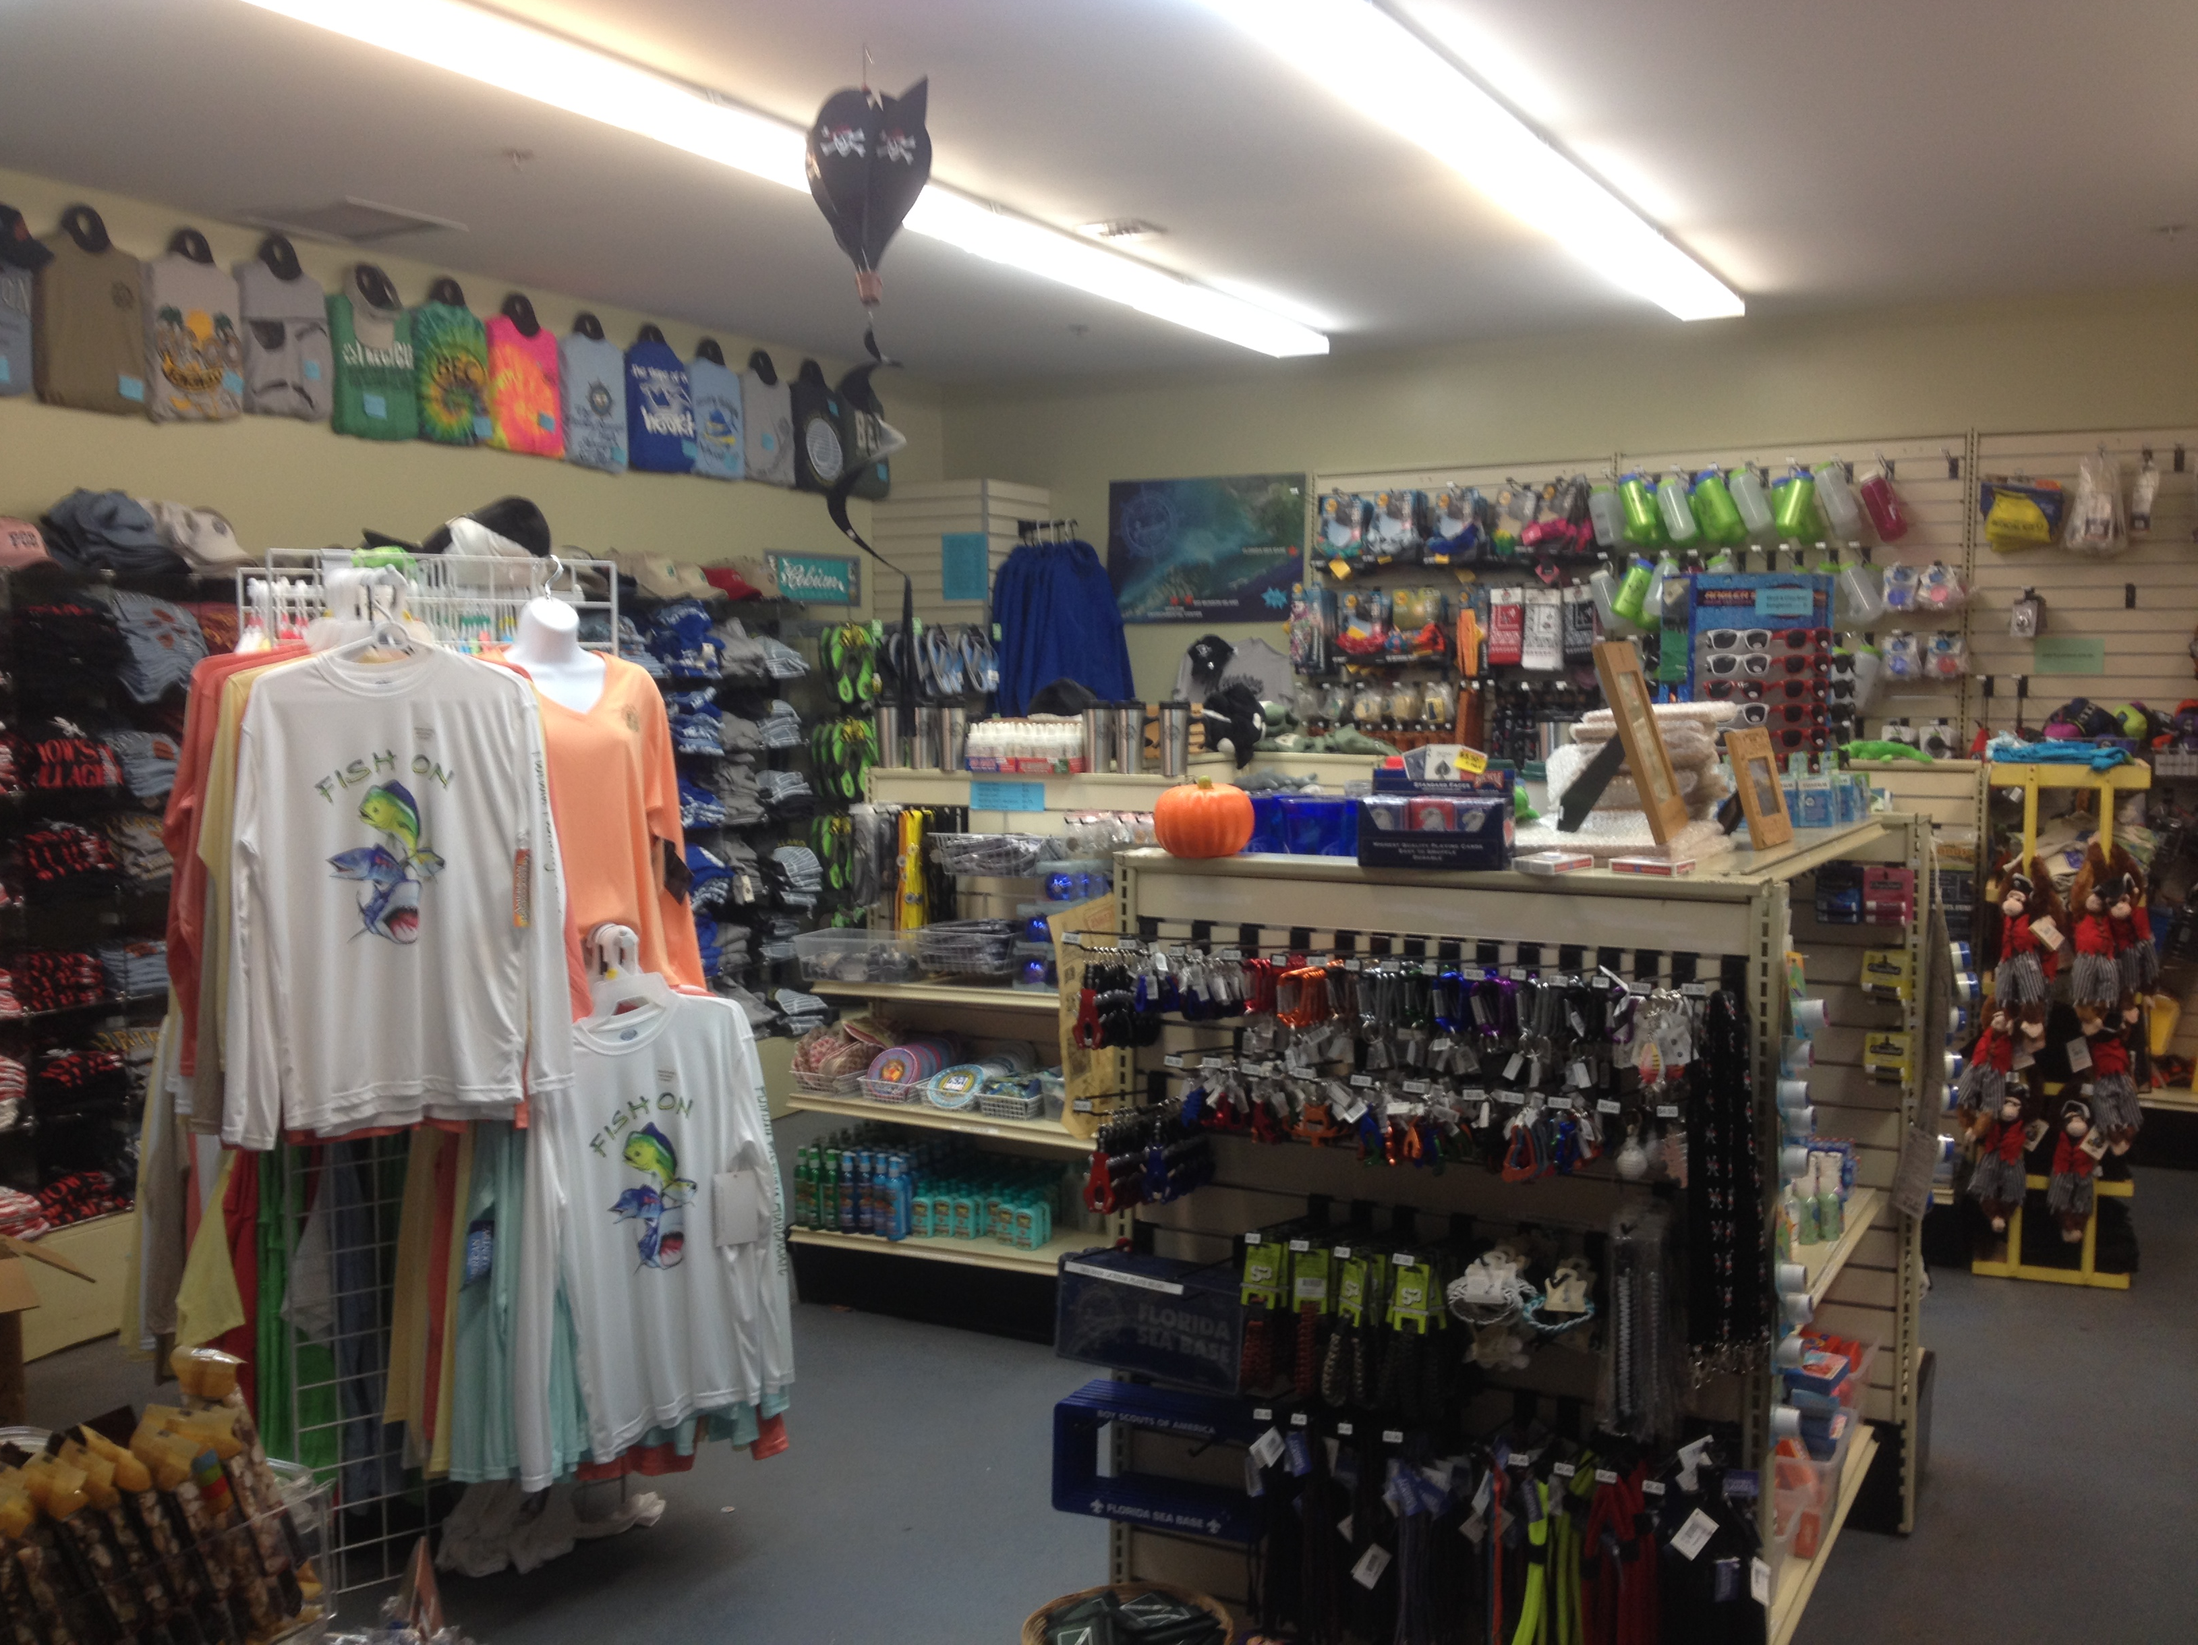
Ship Store
In our wonderful Ship Store you and
your crew can find just about anything!
Fun T-Shirts, water bottles, hammocks, key chains, belts and a whole lot more.
Can’t Pack it on the airplane? No Problem!
We have plenty of sunscreen, bug spray and any other camping necessities you may need.
Visit the Ship Store website at www.store.bsaseabase.org

Slide 11
Frequently Asked Questions
Q: What if I cannot pass the BSA Swim Test prior to arrival? A: You will not be permitted to participate or stay at Sea Base.
Q: What if I cannot complete the Sea Base Swim Review upon arrival? A: You will not be permitted to participate or stay at Sea Base.
Q: What if I arrive without a signed medical? A: All medical documentation must be taken care of in advance and signed by a physician. You will not be permitted to participate or stay at Sea Base.

