Slide 1
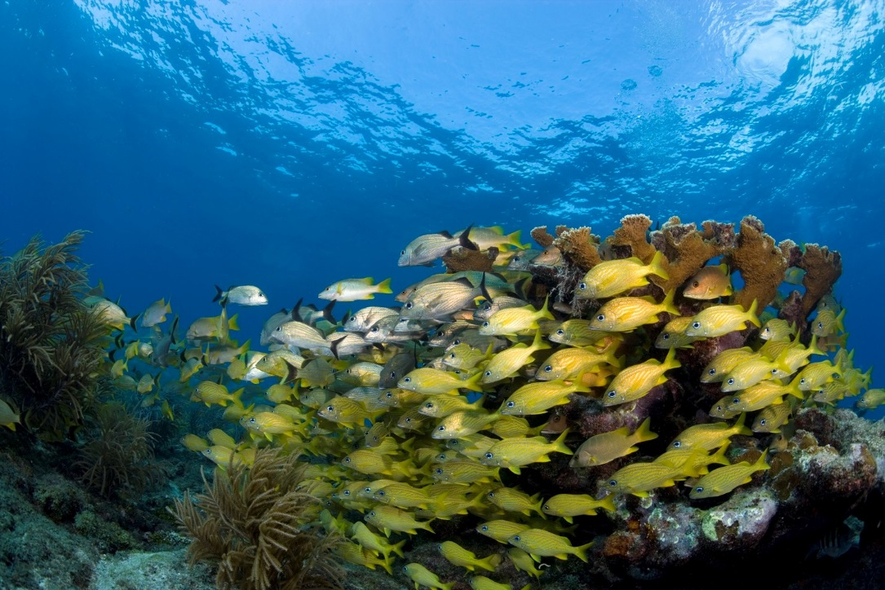

Out Island Adventure

Slide 2
Brief History of Sea Base
The Sea Base began in the early 1970's as a local program in the Florida Keys called the Florida Gateway to High Adventure under the guidance of Sam Wampler, a professional Scouter from the South Florida Council. It offered primarily sailing programs using local marinas and chartered boats sailing to the Bahamas and back. As the idea caught on and grew, it joined the high adventure offerings of the National Council of the BSA along with Philmont Scout Ranch and the Northern Tier High Adventure Base.
In 1979, the Sea Base acquired a permanent facility on Lower Matecumbe Key. It opened for Scouts in 1980 and renamed the Florida National High Adventure Sea Base. As the popularity of this program grew, SCUBA diving was added and in 1984 the BSA received the gift of Big Munson Island from Homer Formby. This undeveloped island offered tremendous program potential as an outpost for primitive camping, Robinson Crusoe style. In 1999, the building of the Brinton Environmental Center began and opened its doors in 2001. Originally starting with the Out Island and Keys Adventure programs, later adding the Florida Fishing Adventure, Order of the Arrow Ocean Adventure, Marine STEM Adventure and a land-based coral nursery.

Slide 3
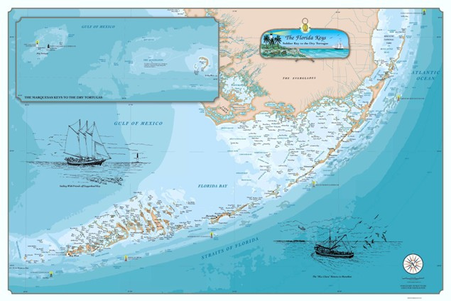
The Florida Keys
Brinton Environmental Center
Mile Marker 23.8
Florida Sea Base
Mile Marker 73.8
Your adventure will take place at the Brinton Environmental Center

Slide 4
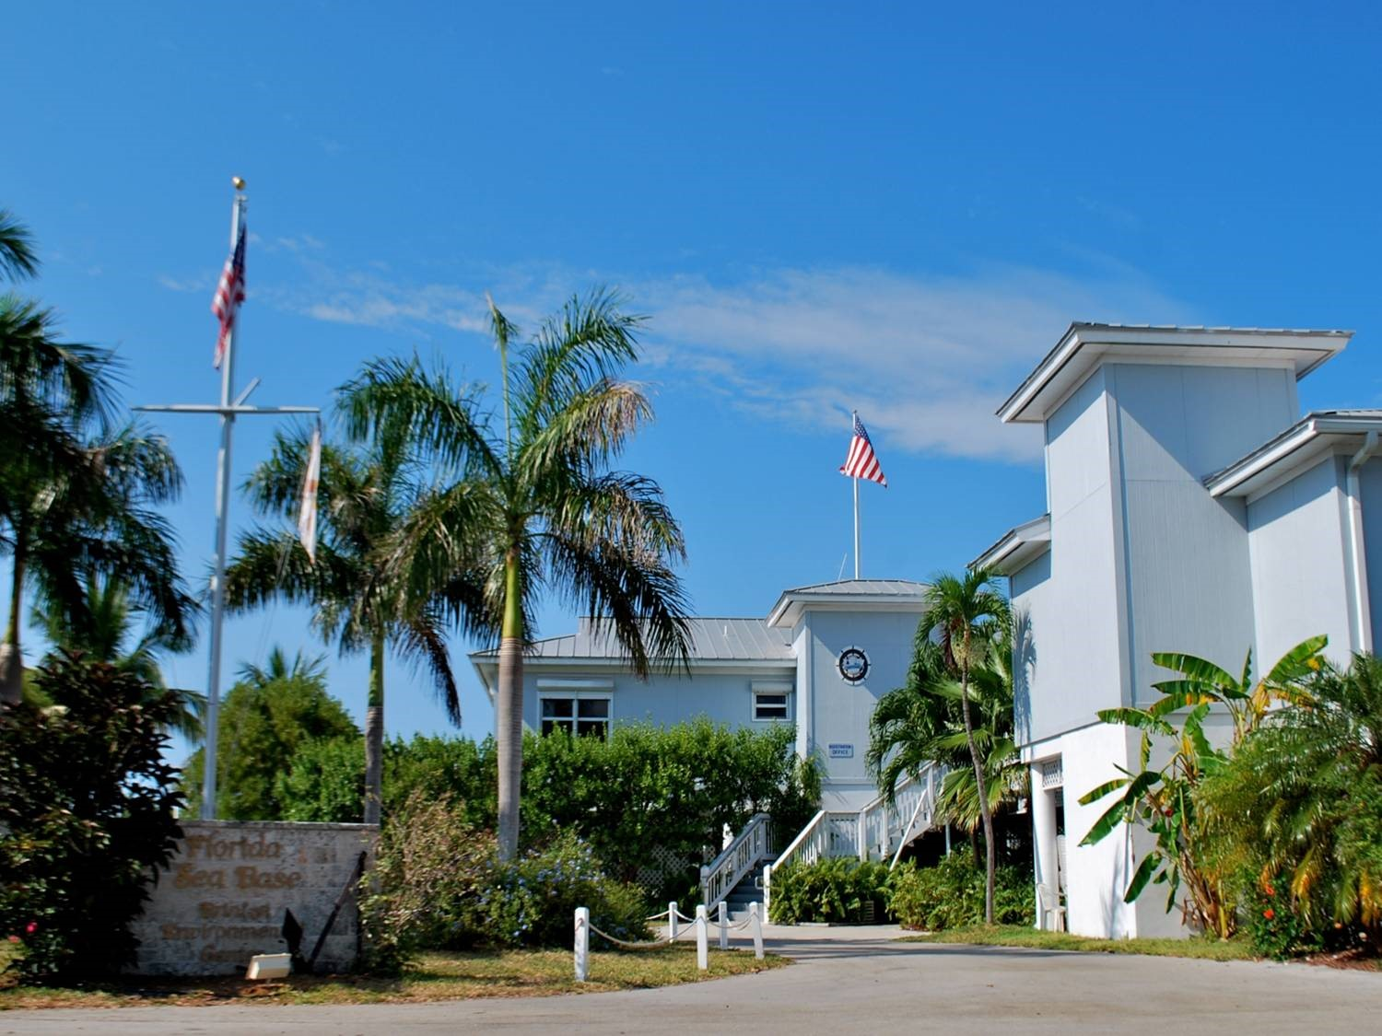
Arrival & Registration
Arrival Time is between 1 PM and 3 PM
Check in and review documents
Meet your Out Island Mate
Check into Dorms
Issue Snorkel Gear and Dry Bag
BSA Swim Review
Snorkel Lesson
Opening Shindig

Slide 5
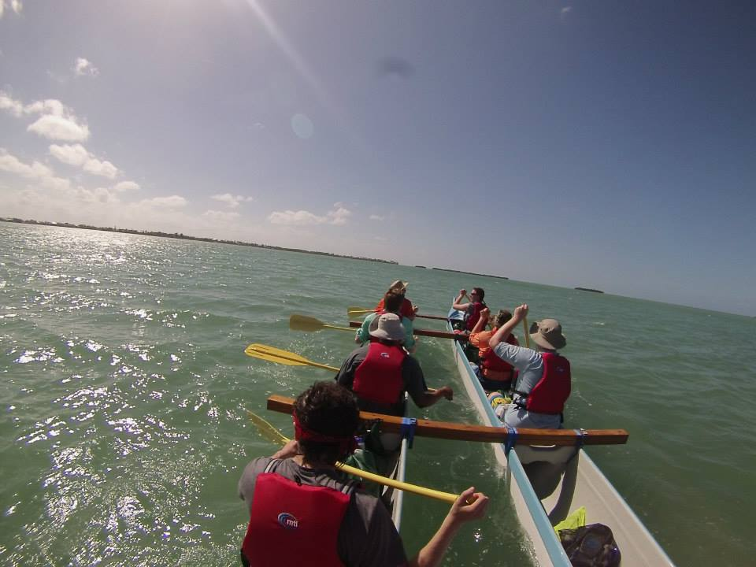
Weekly Schedule
Day One: Arrival Day: Check in, swim and snorkel review, opening shindig
Day Two: Transition day: You will spend the morning loading gear, food, and personal items. After lunch, you will begin the paddle to Big Munson Island.
Day Three: Island Day: You will spend all day exploring the island, shark fishing from docks, kayaking and much more.
Day Four: Fishing Day: A fishing boat will pick you up after breakfast and you spend all day out on the water.

Slide 6
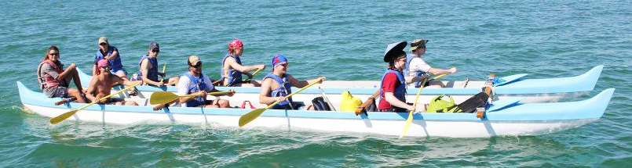
Weekly Schedule (cont.)
Day Five: Snorkel Day: A boat will come to Big Munson Island and pick you up for a half day snorkel trip. The other half of the day is spent completing a S.C.E.N.E. project.
Day Six: Transition Day: After breakfast and camp clean up, you will paddle back to base. That night is your Conch Luau, filled with games and a festive dinner, followed by closing ceremony.
Day Seven: Departure.

Slide 7
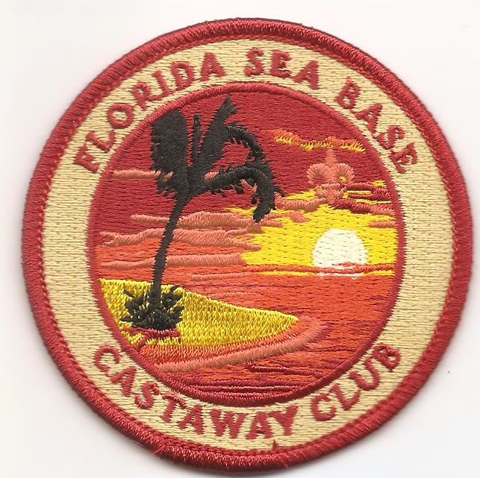
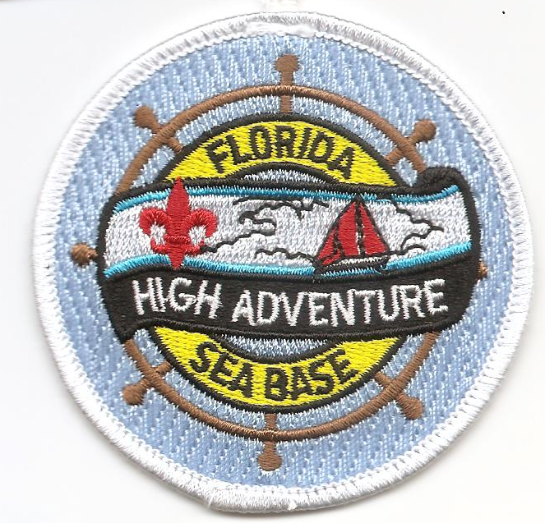
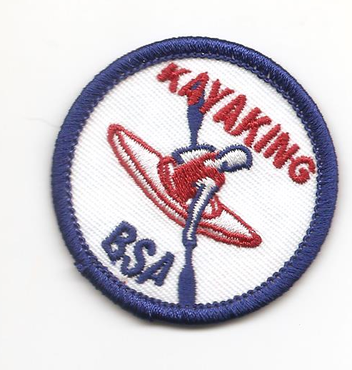
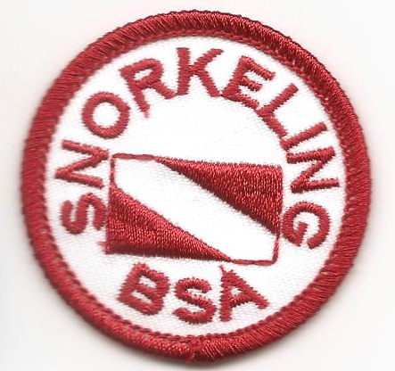
Certifications & Awards
Big Munson Island Castaway Club
S.C.E.N.E.
Duty to God
Kayaking BSA
Snorkel BSA

Slide 8
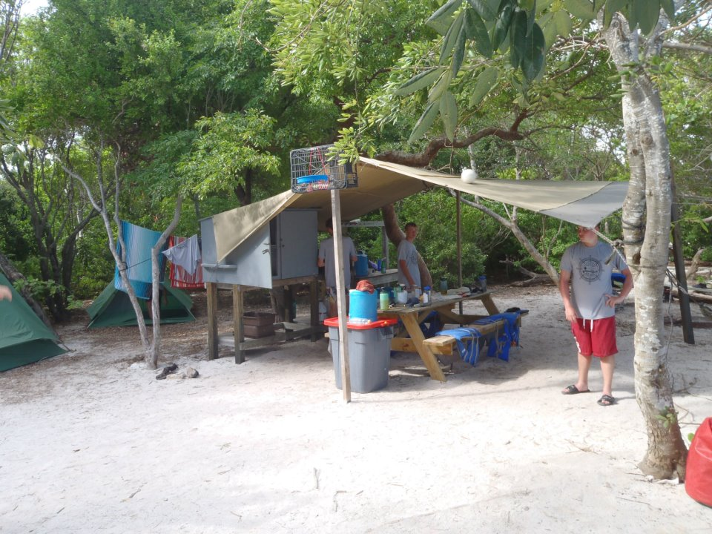
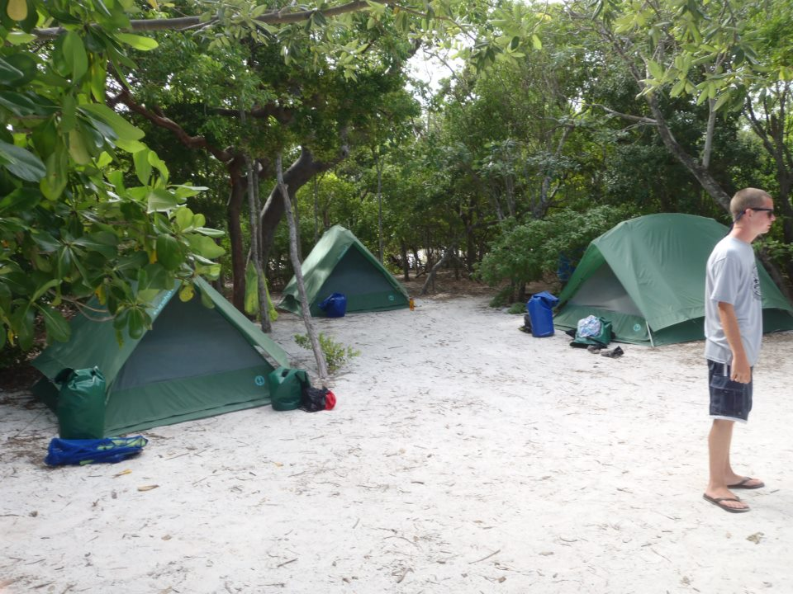
Campsites on the Island
Each campsite is fully stocked with a stove, cooking utensils, plates, cutlery, wash bins and even a coffee percolator (no mess kits needed).
Tents, dining fly and picnic table will be set up before you arrive.
Joy soap and bleach is provided for washing dishes. Hand sanitizer is provided.
Bathrooms on Big Munson Island:
Composting Toilet Systems (CTS) are located near the camping areas. Toilet paper is provided.

Slide 9
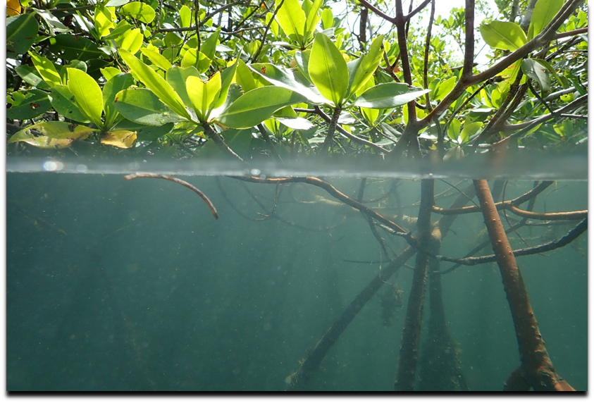
Required Paperwork
Sea Base Check-In Documents
Crew Roster
BSA Annual Health and Medical Records
Unit Swim Classification Record
Adult Leader Training Certificates
WFA & CPR/AED Training Certificate(s)
Pre-Event Medical Screening Checklist
All copies of forms should be placed in a folder or notebook and submitted upon arrival during check in. Please refrain from using plastic sleeves to ensure a timely check in process.

Slide 10
Eligibility Requirements
Crew Rosters completed 90 days prior to arrival
All participants must be 13 years of age or older
Registered member of the BSA
All adult leaders must complete the following adult leader trainings: BSA Safe Swim Defense, BSA Safety Afloat, BSA Hazardous Weather, BSA Youth Protection. Please provide copies of certificates upon arrival
At least one adult leader per crew must have Wilderness First Aid and CPR/AED certifications. Please provide copies of certifications upon arrival
All participants must pass the BSA Swim Test prior to arrival as a Swimmer, evidenced by the Unit Swim Classification Record. All participants must complete the Sea Base Swim Review upon arrival. Non-swimmers will be sent home at their own expense.
Medically Approved for Participation, evidenced by the BSA Annual Health and Medical Record & meets Sea Base Risk Advisory Medical Requirements
Pre-Event Medical Screening Checklist per crew
No participant can exceed 295lbs as evidenced by the medical form. No exceptions will be made. Participants exceeding 295lbs will be sent home at their own expense.

Slide 11
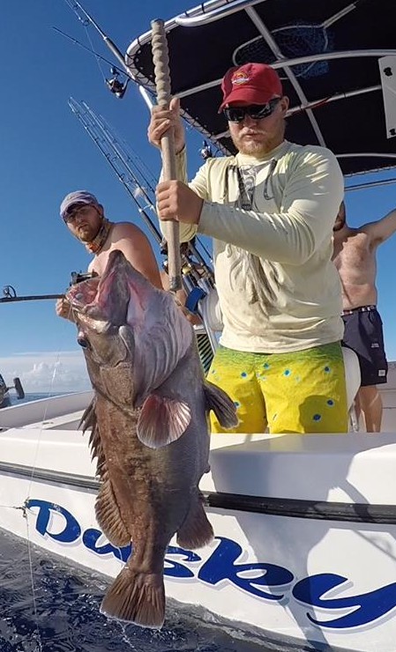
Fishing License
Out Island Adventure participants 16 years of age and older must purchase a 3-day saltwater fishing license.
Your license must begin on the third day of your adventure and can be purchased at gooutdoorsflorida.com. Sea Base does not sell fishing licenses.
Spring Crews (February through April, need to purchase a seven-day saltwater license)
Units arriving between August 6 and March 31 can also purchase a lobster tag.
We do not participate in Lobster Mini Season the last Wednesday/Thursday of July.

Slide 12
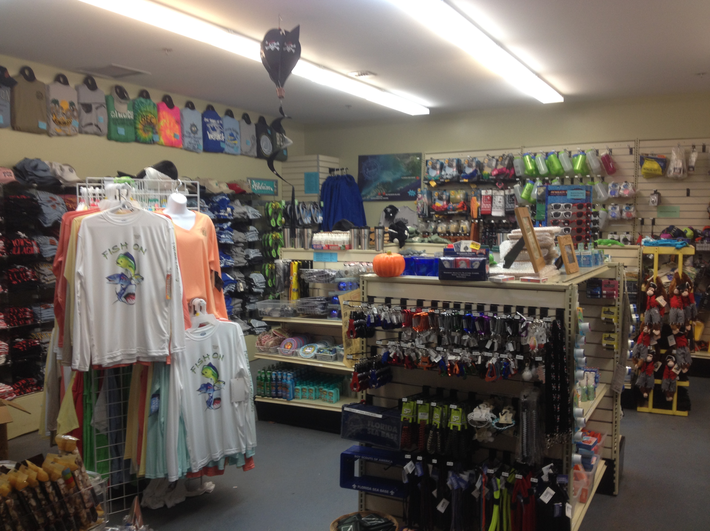
Ship Store
In our wonderful Ship Store you and
your crew can find just about anything!
Fun T-Shirts, water bottles, hammocks, key chains, belts and a whole lot more.
Can’t Pack it on the airplane? No Problem!
We have plenty of sunscreen, bug spray and any other camping necessities you may need.
Visit the Ship Store website at www.store.bsaseabase.org

Slide 13
Frequently Asked Questions
Q: What if I cannot pass the BSA Swim Test prior to arrival? A: You will not be permitted to participate or stay at Sea Base.
Q: What if I cannot complete the Sea Base Swim Review upon arrival? A: You will not be permitted to participate or stay at Sea Base.
Q: What if I arrive without a signed medical? A: All medical documentation must be taken care of in advance and signed by a physician. You will not be permitted to participate or stay at Sea Base.

