Slide 1
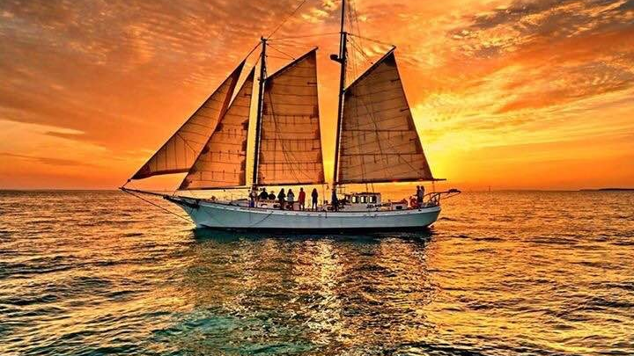
Sea Base High adventure
2024 Programs Information Session
Capt. Dylan Cordle, Program Director-Sailing
Dylan.Cordle@scouting.org
(305) 664-5626

Slide 2
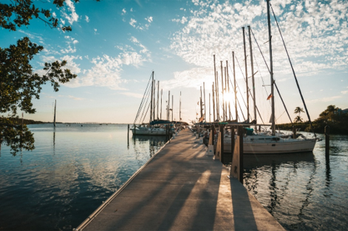
Sailing Programs
Participant Guides
Coral Reef Sailing (6 days/5 nights)
  Crew Size: 6-8
  CR 071024 A
STEM Eco Sailing (6 days/5 nights)
  Crew Size: 10-12
  ES 071024 A
Keys Adventure Sailing (6 days/5 nights)
  Crew Size: 6-8
  KS 071024 A
Sea Exploring (7 days/6 nights)
  Maximum Crew Size: 20
  SE 071024 A

Slide 3
Eligibility
General Eligibility
Adult Leader Eligibility
Registered Member of BSA
BSA Swim Classification-Swimmer
12 years of age
  12-year-old participants are suggested to have a parent attend with them
Medically Approved to Participate
  (BSA AHMR)
Registered Member of BSA
BSA Swim Classification-Swimmer
Medically Approved to Participate
Completed Training Certificates
  YPT, Safe Swim Defense, Safety Afloat, Haz. Weather, and one adult must have WFA and one adult must be CPR/AED certified.
21 years of age or older
Ratios of males to females and youth to adults

Slide 4
Paperwork
At a Glance-By Crew
At a Glance-For Adults
Crew Roster (90 days prior to arrival)
Pre-Event Medical Screening
  Should be filled out just prior to departing for Sea Base.
Vessel Liability Waiver (first 2 spots left blank)
  Have parents sign for youth prior to departing
Unit Swim Classification
BSA AHMR (BSA Medical)
  Must be 2019 version
  Good for one year
  Copies of Insurance Cards (Front & Back)
At least one adult leader
  CPR/AED
  Wilderness First Aid or greater certification (course must have in-person section)
Each adult leader
  Youth Protection Certificate
  Safe Swim Defense Certificate
  Safety Afloat Certificate
  Hazardous Weather Certificate

Slide 5
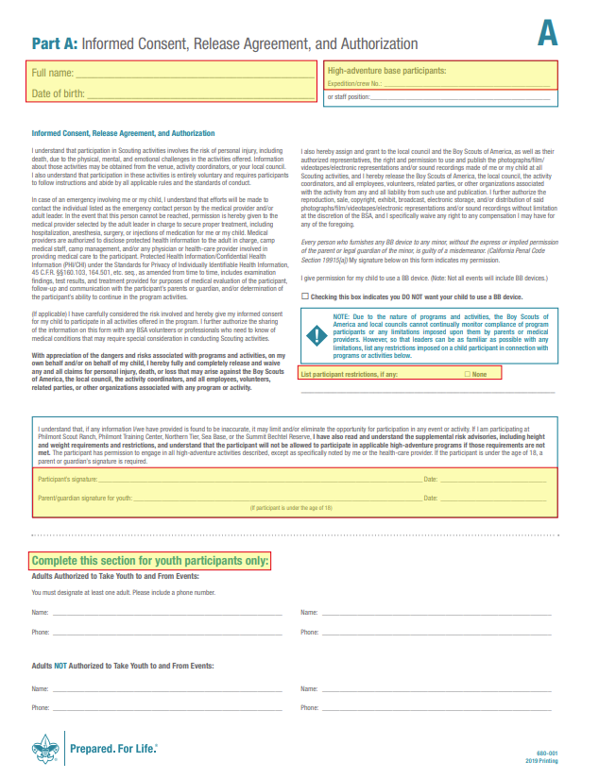
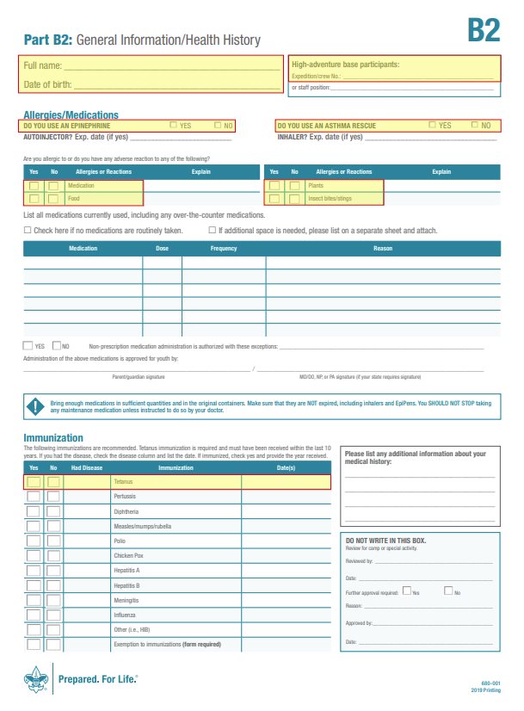
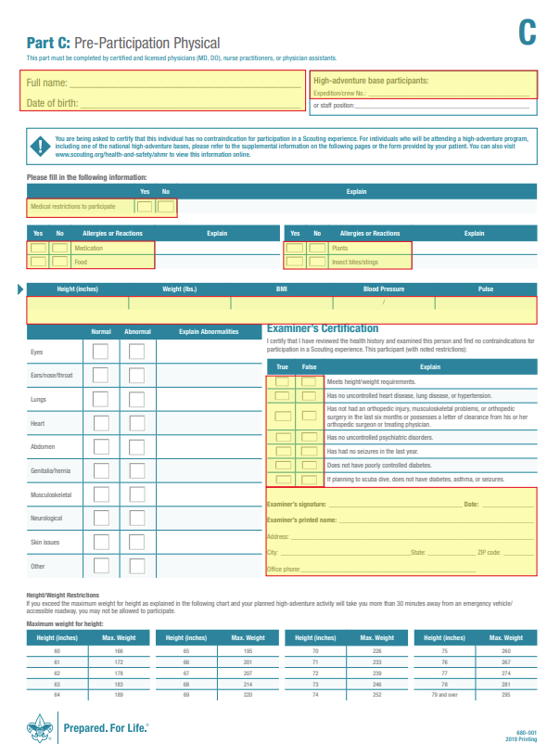
Common mistakes on the medical

Slide 6
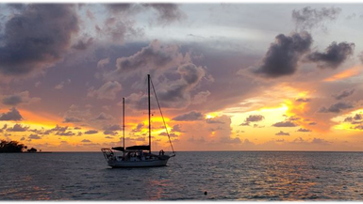
Coral reef sailing
6 day/5 night adventure (For example - Arrive Sunday, depart Friday)
Arrival day: Arrive between 1-3 pm at Florida Sea Base
    73800 Overseas Hwy. Islamorada, FL 33036
  Check-in: Paperwork check, crew photo, gear shakedown, snorkel gear checkout, snorkel review
  If your crew arrival day is before Daylight Savings Time changes, we ask that you arrive BY 1:00 PM so that you can board and set sail on arrival day
Days 2-5: Enjoying your adventure aboard a 40+ ft. sailing vessel snorkeling the reefs of the Florida Keys, learning to sail, and fishing to your heart’s content.
Departure day: Boat will return to dock between 8:30-9:30. Crew will help captain clean vessel, shower up, and be able to check out the Ship Store. We ask crews to depart by 11 am.

Slide 7
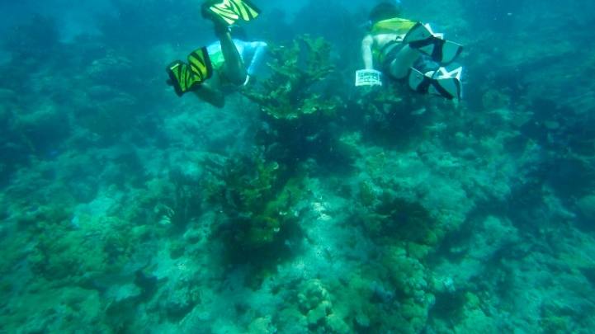
Stem eco sailing
6 day/5 night adventure (For example - Arrive Sunday, depart Friday)
Arrival day: Arrive between 1-3 pm at Florida Sea Base
    73800 Overseas Hwy. Islamorada, FL 33036
  Check-in: Paperwork check, crew photo, gear shakedown, snorkel gear checkout, snorkel review
  If your crew arrival day is before Daylight Savings Time changes, we ask that you arrive BY 1:00 PM so that you can board and set sail on arrival day
  Crews will be split up onto two boats for the week. The boats will share a similar float plan
Days 2-5: STEM Eco crews will have a mate aboard delivering marine ecology curriculum. Each day crews will learn about a different marine ecosystem, snorkeling, kayaking, fishing, and sailing through them, all while living aboard a 40+ ft sailboat.
Departure day: Boat will return to dock between 8:30-9:30. Crew will help captain clean vessel, shower up, and be able to check out the Ship Store. We ask crews to depart by 11 am.

Slide 8
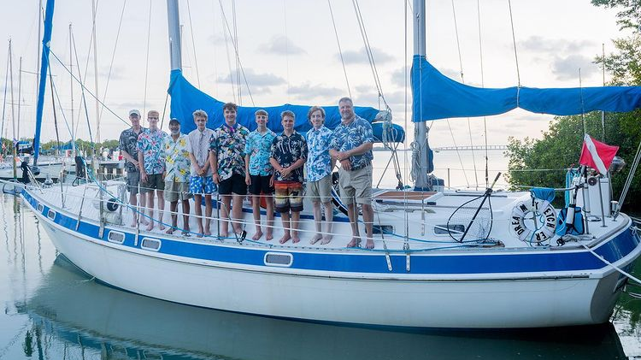
Keys adventure sailing
6 day/5 night adventure (For example - Arrive Sunday, depart Friday)
Arrival day: Arrive between 1-3 pm at Florida Sea Base
    73800 Overseas Hwy. Islamorada, FL 33036
  Check-in: Paperwork check, crew photo, gear shakedown, snorkel gear checkout, snorkel review
  If your crew arrival day is before Daylight Savings Time changes, we ask that you arrive BY 1:00 PM so that you can board and set sail on arrival day
Days 1-3 will be spent aboard vessel enjoying the blue waters of the Florida Keys and everything they have to offer.
  Afternoon of Day 3 boat will return to dock and crew will disembark
Days 4-5: Crews will be participating in land-based activities such as kayaking/SUP, snorkeling, small boat sailing, and an island tour from one of our power boats
  Evening of Day 5 crews will participate in luau dinner
Departure day: Breakfast will be served at 8 am. Crews can leave earlier if needed. Crews are asked to depart by 10 am.

Slide 9
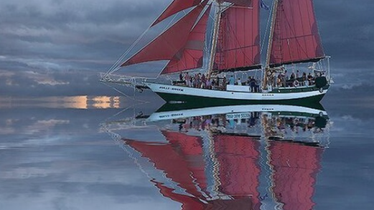
Sea exploring schedule
7 day/6 night adventure (For example - Arrive Sunday, depart Saturday)
Arrival day: Arrive between 1-3 pm at Florida Sea Base
    73800 Overseas Hwy. Islamorada, FL 33036
  Check-in: Paperwork check, crew photo, gear shakedown, snorkel gear checkout, snorkel review
  Crews will sleep in dorms first night and take van to the boat after breakfast day 2
Days 2-6 will be spent aboard vessel learning to crew a tall ship. Crews will be hauling lines, raising sails, and may even get some helm time on the 60-70 ft. schooner by the end of the week.
  A midweek day will be spent in Key West where your crew will get to explore the city with one of the richest smuggling histories in the country.
  Crews will take a van back to Sea Base on the afternoon of Day 6
  Evening of Day 6 crews will participate in luau dinner
Departure day: Breakfast will be served at 8 am. Crews can leave earlier if needed. Crews are asked to depart by 10 am.

Slide 10

A new adventure is on the horizon………….

Slide 11
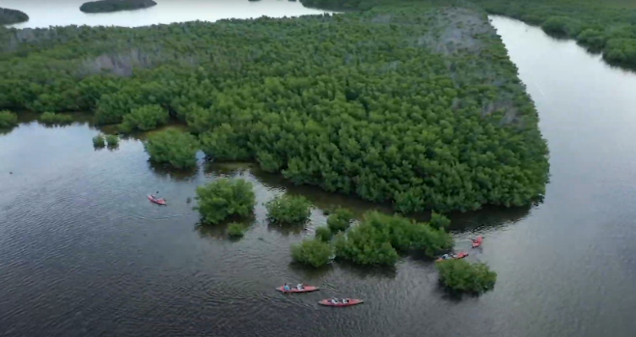
Island expedition schedule
6 day/5 night adventure (For example - Arrive Sunday, depart Friday)
Arrival day: Arrive between 1-3 pm at Florida Sea Base
    73800 Overseas Hwy. Islamorada, FL 33036
  Check-in: Paperwork check, crew photo, gear shakedown, snorkel gear checkout, snorkel review
Day 2 will include EITHER a trip to Long Key State Park where crews will kayak a mangrove forest followed by an afternoon hike on the Golden Orb Trail.
OR
Day 2 will be spent aboard one of our 28 ft fishing vessels trying to catch dinner.
Days 3 will be spent doing the activity you did not do on day 2.
Days 4 and 5 will be spent on one of our Dive Newtons bound for the world’s third largest barrier reef.
  Evening of Day 5 crews will participate in luau dinner
Departure day: Breakfast will be served at 8 am. Crews can leave earlier if needed. Crews are asked to depart by 10 am.

Slide 12
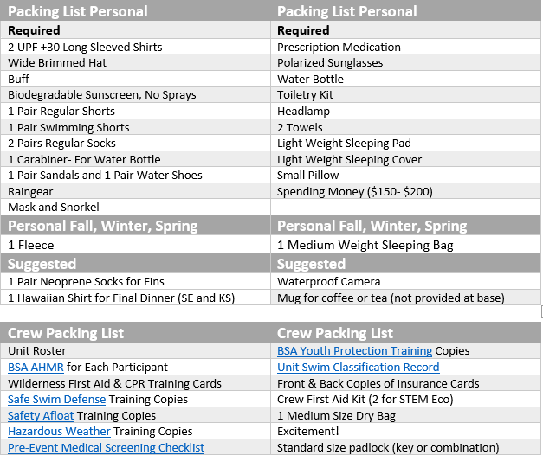
Prep and Packing list

Slide 13
Prep and packing faq
How should I pack all my stuff?
Sea Base provides mesh bags that are 12” x 12” x 20” for you to transfer your gear into upon arrival. Alternatively, you can choose to source your own bag from the Ship Store. Crews have a 3’ x 3’ x 3’ storage locker for items not going on the boat.
What mask and snorkel should I bring?
You can purchase a mask and snorkel from the Sea Base Ship Store or go to your local dive shop or even Walmart. Anything that you are comfortable in will work. *Full facemasks are NOT permitted*
Should I bring fishing gear?
Sea Base will provide all fishing gear you will need.
Should I bring a water bottle?
You should bring a Nalgene-style, reusable water bottle. Please do not bring metal water bottles.
What kind of shoes should I bring?
While aboard the sailboats, most captains do not allow shoes, and you will find that you will not need them as you will be in and out of the water so frequently. Accommodations can be made for individuals with medical conditions that require footwear.

Slide 14




General faq
Will there be coffee?
There is coffee provided in the Sea Base galley, and we will provision each boat with coffee. We do not provide coffee mugs, though.
Will I be able to charge my phone?
That is not guaranteed. The suggestion is to keep your phone in airplane mode and only use it for pictures. Take full advantage of this opportunity.
Will there be power on the boat for me plug in my CPAP machine?
That is not guaranteed. The suggestion is to bring batter backups for your CPAP machine.
What are sleeping arrangements like?
Most crews choose to sleep on deck. As such, a backpacking style sleeping pad and light blanket or sleeping bag is suggested.
The staff and captains at Sea Base want to make your adventure one that will create lifelong memories! When planning your trip, keep that in mind, and do not hesitate to reach out with any further questions!

