Slide 1


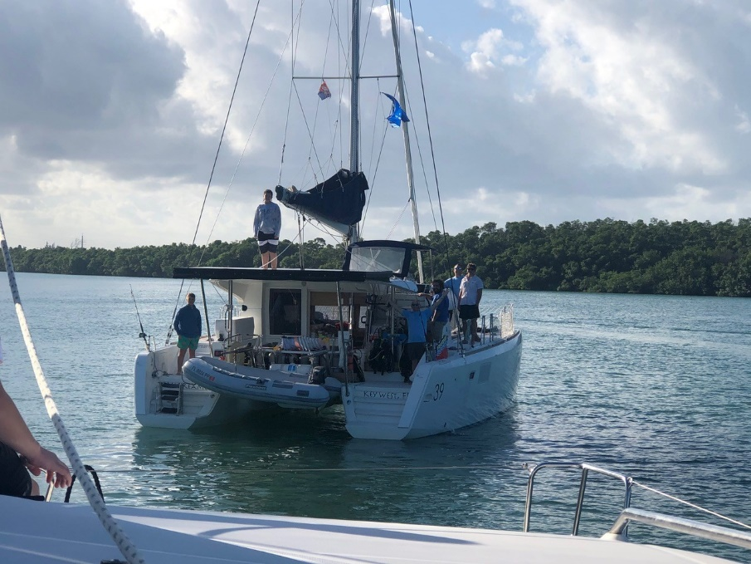
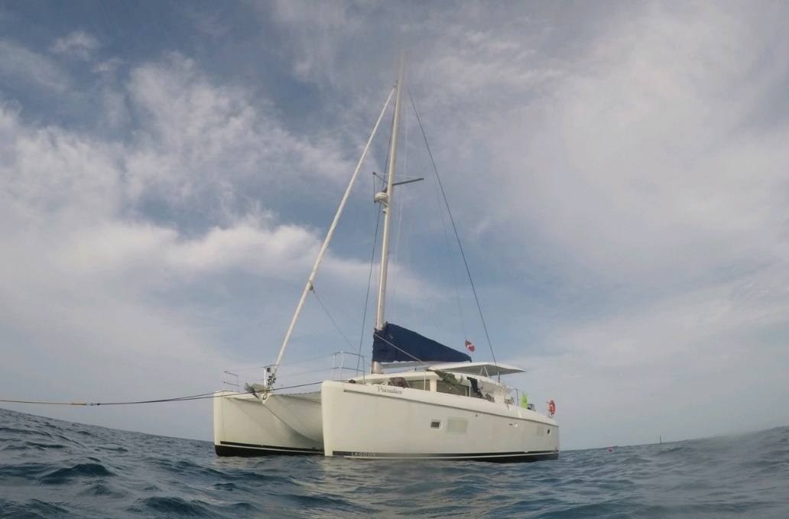
SCUBA Live Aboard

Slide 2

Brief History of Florida Sea Base
The Sea Base began in the early 1970's as a local program in the Florida Keys called the Florida Gateway to High Adventure under the guidance of Sam Wampler, a professional Scouter from the South Florida Council. It offered primarily sailing programs using local marinas and chartered boats sailing to the Bahamas and back. As the idea caught on and grew, it joined the high adventure offerings of the National Council of the BSA along with Philmont Scout Ranch and the Northern Tier High Adventure Base. In 1979 the Sea Base acquired a permanent facility on Lower Matecumbe Key and when this opened for Scouts in 1980 it was renamed the Florida National High Adventure Sea Base. As the popularity of this program grew, scuba diving was added and in 1984 the BSA received the gift of Big Munson Island from Homer Formby. This undeveloped island offered tremendous program potential as an outpost for primitive camping, Robinson Crusoe style. During this time period the sailing program concentrated on sailing around the fabulous Florida Keys. New sailing programs were started that originated and ended in Marsh Harbour in the beautiful Abaco Islands of the Bahamas.

Slide 3
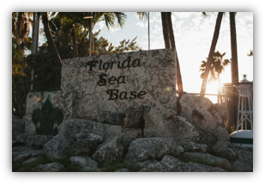
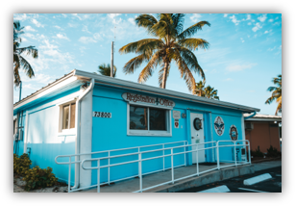
Arrival and Registration
Arrival Time is 1 PM
Check in
Meet your Professional Sea Base Divemaster
Check into Scuba Dorms
Crew Photos taken
Issue Equipment
Scuba Review
Swim Review

Slide 4
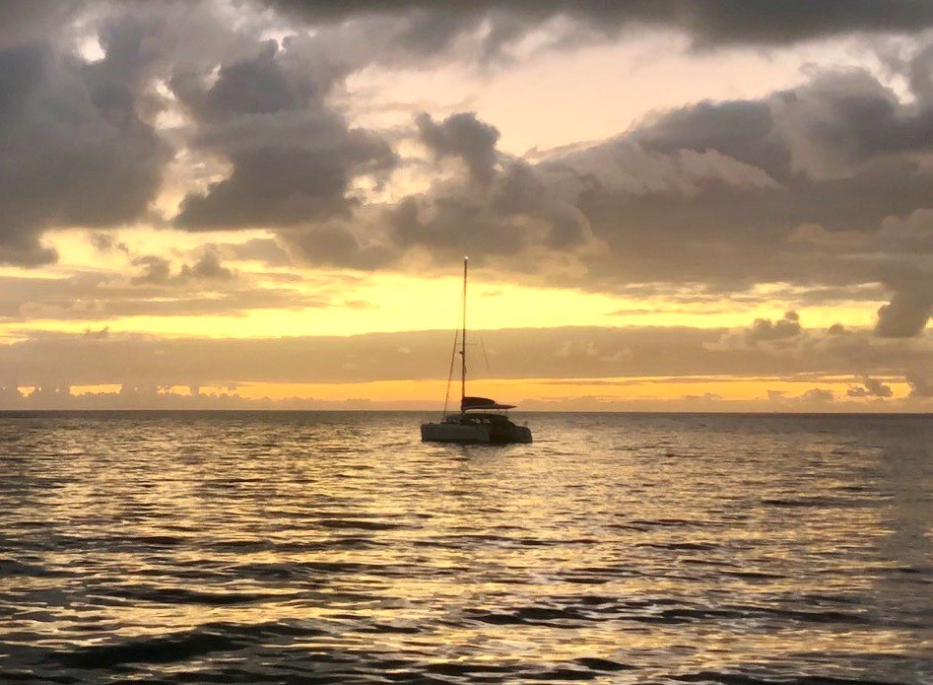
Weekly Schedule
Arrival Day Registration, swim test and scuba skills review
Orientation
Day Two Scuba Review make up/
Pack all equipment for the boat
Provision boat
Depart Sea Base
Day Three - Five Open Water Dives and snorkeling
Day Six - Last dive, clean boat depart for Sea Base
Luau
Day Seven Departure
Schedule is weather dependent

Slide 5




Skills and Explorations Your Crew Will Accomplish
Compass Navigation Skills Dive Against Debris
Natural Navigation Skills Coral Bleaching Identification
Advanced Buoyancy Skills Night Diving Skills
Reef Fish and Invertebrate Identification

Slide 6
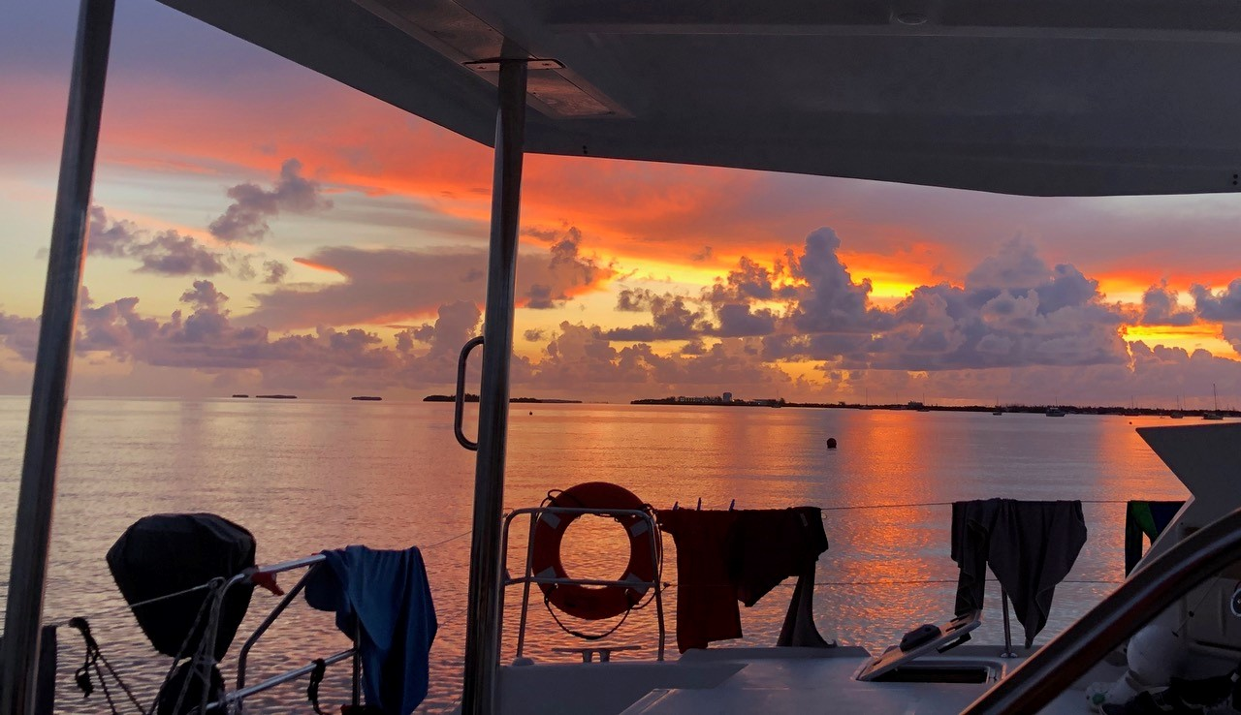
Certifications and Awards
S.C.E.N.E.S. Ambassador Award
BSA Snorkel Award
Duty to God
Sea Base Scuba Participation Card

Slide 7
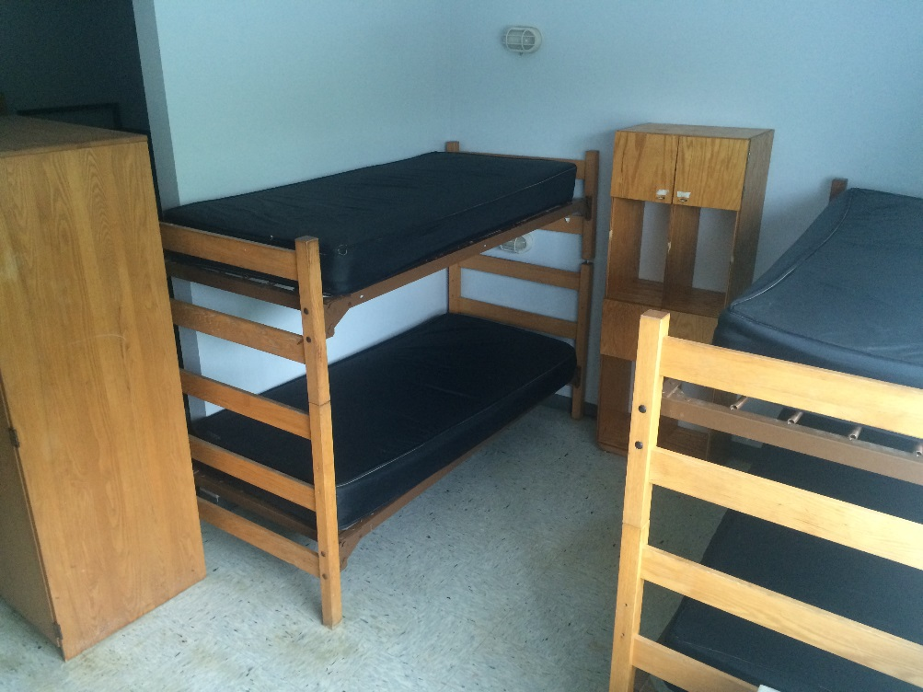
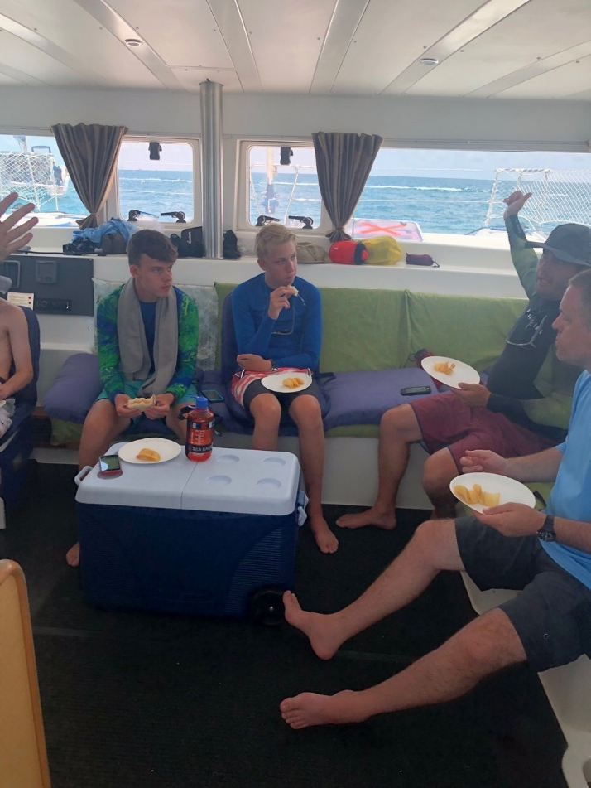
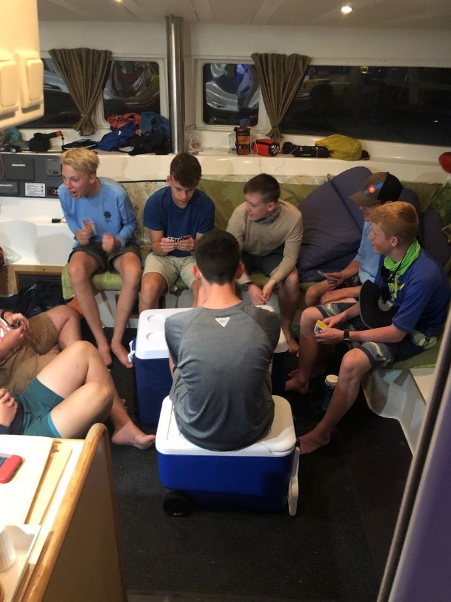
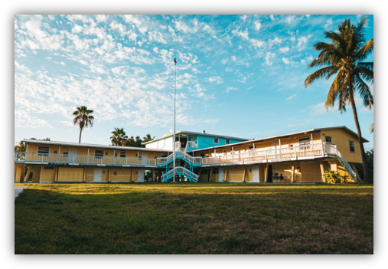
Dorm
Dorms are provided for you first and last night of your adventure
Please bring your own bedding, mattresses are provided
Separate dorm rooms for women
All rooms are air conditioned
Youth and adults will be in one dorm room

Slide 8
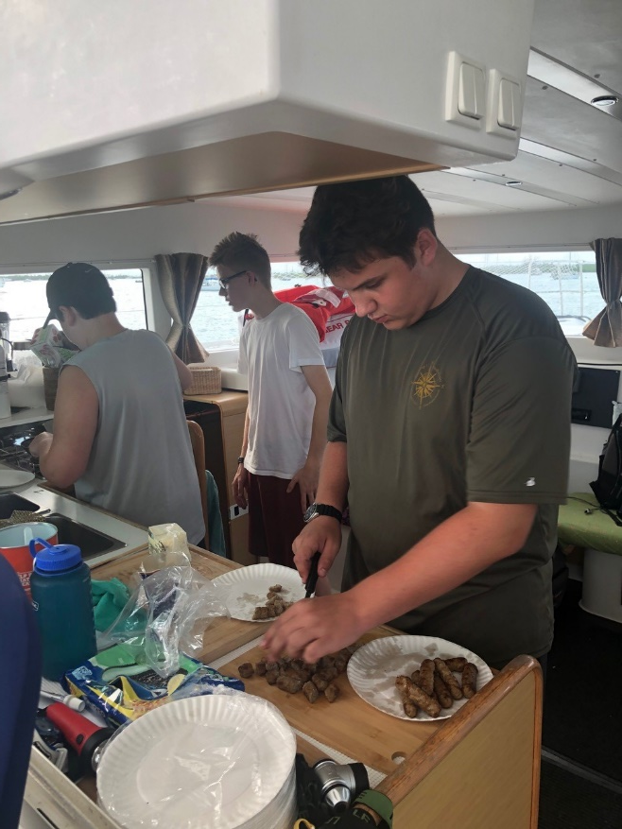


Galley
First and last day meals served at the galley
All other meals prepared by you while on the boat
Those with special food needs please
contact us prior to your arrival
FSB.Galley@scouting.org
Sea Base Blessing
Bless the creatures of the Sea
Bless this person I call me
Bless the Keys you made so grand
Bless the sun that warms the land
Bless the fellowship we feel
as we gather for this meal
Amen

Slide 9
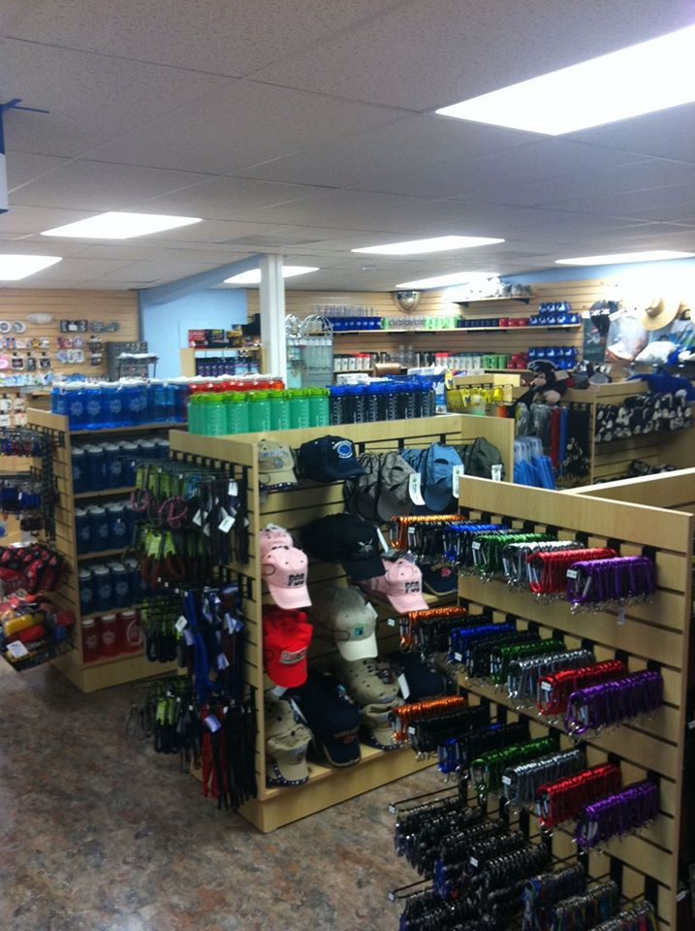
Ships Store
Open Everyday during season
Order Custom Crew Apparel
Shirts
Hats
Duffel Bags
*Custom orders must be placed six weeks prior to arrival
Reserve wetsuits
Mask and Snorkels
Water bottles, sunscreen and a large
assortment of souvenirs.
store.bsaseabase.org

Slide 10

Scuba Equipment
Sea Base is proud to offer Aqualung equipment
as our exclusive scuba equipment provider. The following equipment is provided for your adventure.
Pro HD BC’s with weight integration
Calypso Regulators with alternate air sources
3 gauge consoles include pressure gauge, depth gauge and compass
(dive computers not provided or available for rent)
Amika fins (no booties required)*
Dive light provided for night dives
*If you have a foot size of 13 or larger we may not have fins to fit you, and it is suggested to supply your own fins.

Slide 11
Scuba Equipment
Sea Base does not provide nor rent the following equipment
Mask and snorkel
Dive Watch
Dive computers (not required)
Full wetsuits available for rent (only needed for winter and spring programs)
Masks, snorkels and dive watches are available for purchase through the Ships Store

Slide 12
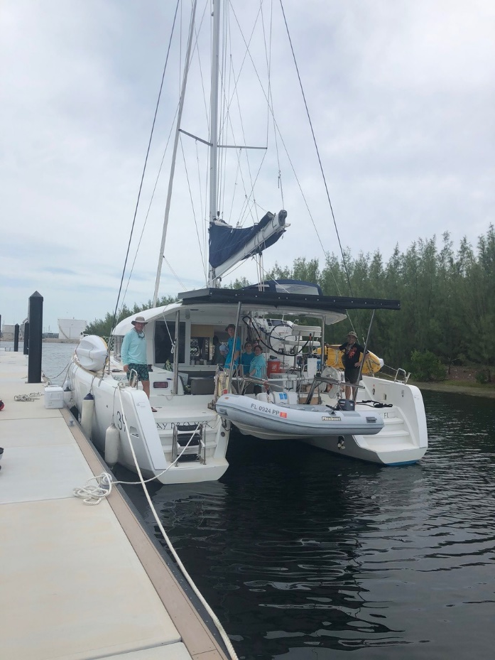
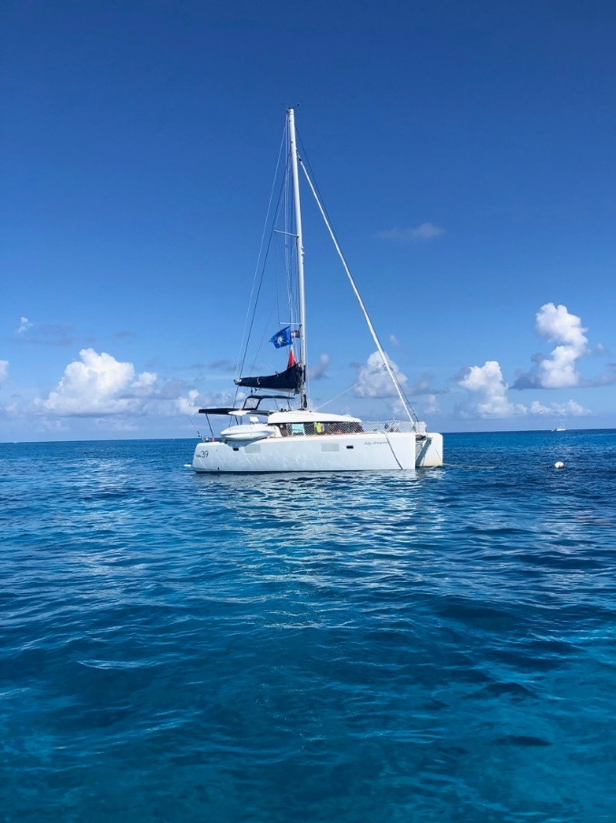
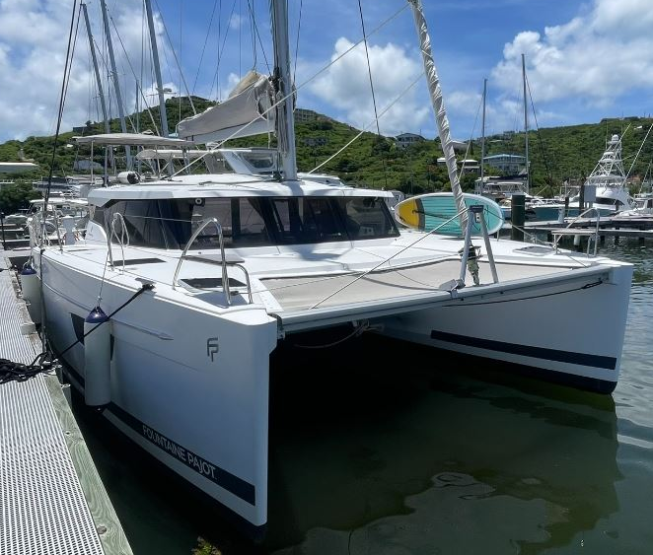
Scuba Live Aboard Fleet
There are three Catamarans used in our Live Aboard Adventures:
SV Beyond 37 ft. Leopard
SV Day Dreamer 38.5 ft. Lagoon
SV Peaceful Sol 38.5 ft Fountaine Pajot
All boats have Oxygen, AED’s, underwater recall systems, First Aid Kits, Marine Head, and VHF Radios.

Slide 13
12 Passenger Live Aboard Adventure
This adventure can accommodate up to 12 participants.
Your crew will be placed on two vessels.
This adventure can accommodate up to 12 participants. The only difference between the 12 Passenger Live Aboard Adventure and the 6 Passenger Live Aboard Adventure is the number of participants. Everything else is exactly the same.

Slide 14
6 Passenger Live Aboard Adventure
This adventure can accommodate up to six participants. The only difference between the 6 Passenger Live Aboard Adventure and the 12 Passenger Live Aboard Adventure is the number of participants. Everything else is exactly the same.

Slide 15
Scuba Medical Document Procedure
All documents that are needed for the Scuba Live Aboard Programs will be sent to your Crew Leader. The Crew Leader will collect all documents, review them for completeness and forward them to Sea Base as a crew package.
  For Spring crews this is due no later than January 1st
  For Summer crews this is due no later than March 1st
  For Winter crews this is due no later than October 1st
Documents returned after the deadline may affect your crew’s ability to participate in their full adventure.
*As a special note: It is suggested that you keep a copy of the BSA Medical and RSTC Diver Medical Questionnaire for your personal records.

Slide 16
Scuba Medical Document System
Required documents for Scuba Live Aboard Adventure:
BSA Parts A, B and C signed by a physician (MD, DO, PA or NP)
RSTC Diver Medical Questionnaire signed by a physician (MD, DO, PA or NP)*
PADI Diver Activities Release*
Health Insurance Card (both sides)
Scuba Certification Card (both sides)
PADI Florida Addendum Notice to the Minor Child’s Parent
Vessel Release
If there is a participant that is in a Severe-Risk or Relative-Risk category or is taking a prescribed medication for ADD, ADHD or depression, this document must be signed by an MD or DO only.
*These are two or three page documents and all pages are required

Slide 17

Medical Fitness for Scuba Diving
The following pages are meant to be a guide for the more common conditions and not an
absolute list. If you have a medical condition that may be of concern, please contact the Scuba Department at Sea Base for guidance.
The final decision for participation in all Sea Base program is at the discretion of the
Sea Base Medical Director. The decision is final, and we are unable to Reverse or alter that decision.
No waivers will be issued.

Slide 18
Absolute medical contradictions for scuba diving with the BSA
Asthma
Epilepsy/Seizures
Insulin dependent diabetes
Multiple (more than one) medication for ADD, ADHD or depression
Anxiety requiring medication
Narcolepsy
Spontaneous pneumothorax
Exceeding the weight limit of 295 pounds
Loss of hearing in one ear
NOTE: For additional information read the detailed description on the following slides or in the Participant Guide.
Not every disqualifying medical condition for scuba diving is listed
The final decision for participation in all Sea Base program is at the discretion of the
Sea Base Medical Director. The decision is final, and we are unable to reverse or alter that decision.
No waivers will be issued.

Slide 19
Risk factors for Scuba Diving with the BSA
Ear and Sinus Problems ● Panic Disorder
Recent surgery ● Active psychosis
Leukemia ● Certain Medications
Chemotherapy ● Migraines with auras or requiring medication
Sickle-cell disease ● Pregnancy
Blood thinners ● Pacemakers
NOTE: For additional information read the detailed description on the following slides or in the Participant Guide.
Not every disqualifying medical condition for scuba diving is listed
The final decision for participation in all Sea Base program is at the discretion of the
Sea Base Medical Director. The decision is final, and we are unable to reverse or alter that decision.
No waivers will be issued.

Slide 20
Medical Fitness for Scuba Diving
BSA Annual Health and Medical Record Part C and RSTC Diver Medical Questionnaire must be signed by a physician (MD, DO, PA or NP Only) within the last year. If there is a participant that is in a Severe-Risk or Relative-Risk category or is taking a prescribed medication for ADD, ADHD or depression, this document must be signed by an MD or DO only.
Medical issues:
Hypertensive: Blood pressure must be lower than 140/90 prior to arrival at Sea Base.
The final decision for participation in all Sea Base program is at the discretion of the
Sea Base Medical Director. The decision is final, and we are unable to reverse or alter that decision.
No waivers will be issued.

Slide 21
Medical Fitness for Scuba Diving
Seizures (Epilepsy):
Seizures while snorkeling or scuba diving are extremely dangerous and often fatal.
Diving or snorkeling as part of an official scouting activity is prohibited for participants with a history of seizures
No participant with a history of seizures or taking anti-epileptic medication may snorkel or scuba dive. Prospective
participants with a history of febrile seizures may be considered for snorkeling or scuba diving after a formal
consult with their neurologist.
The final decision for participation in all Sea Base program is at the discretion of the
Sea Base Medical Director. The decision is final, and we are unable to reverse or alter that decision.
No waivers will be issued.

Slide 22

Medical Fitness for Scuba Diving
Weight Limits:
Due to rescue equipment restrictions and evacuation efforts from remote sites, under no circumstances will any individual exceeding 295 pounds be permitted to participate. Anyone arriving at Sea Base exceeding 295 pounds will be sent home at their own expense. No refund will be given.
Concussions:
Those participants who have suffered a concussion and any side effects from the concussion should contact Sea Base to discuss this issue. Please provide the following information on the BSA Medical:
  When did the injury occur?
  Was there any loss of consciousness, inability to recollect events?
  Were there reports of disorientation after the incident?
  Have there been any lingering affects?
The final decision for participation in all Sea Base program is at the discretion of the
Sea Base Medical Director. The decision is final, and we are unable to reverse or alter that decision.
No waivers will be issued.

Slide 23

Medical Fitness for Scuba Diving
Psychological and Emotional Difficulties (ADD, ADHD, anxiety and depression)
Any condition should be well controlled
Diving as part of an official scouting activity is prohibited for
  Participants taking more than one medication for any of these conditions
  Participants with anxiety disorder requiring medication
Anxiety Medication: Participants with anxiety requiring medication will not be cleared to scuba dive.
***Medications***
Participants, youth or adult, taking multiple medications for ADD, ADHD, depression or any psychological condition will not be cleared for scuba diving. Those Participants requiring medication to control anxiety will not be cleared for scuba diving. Those that are currently certified or have a physician’s approval for scuba diving will not be cleared to scuba dive at Sea Base. There are no exceptions, exclusions or waivers to this policy.
The final decision for participation in all Sea Base program is at the discretion of the
Sea Base Medical Director. The decision is final and we are unable to reverse or alter that decision.
No waivers will be issued.

Slide 24

Medical Fitness for Scuba Diving
Asthma or Reactive Airway Disease:
Diving as part of an official scouting activity is prohibited for persons being treated for asthma or reactive airway disease
Persons with a history of asthma who have been asymptomatic and have not used medications to control asthma for five years or more may be allowed to scuba dive if resolution of asthma is specifically confirmed by their physician and includes provocative pulmonary function testing conducted by a pulmonologist.
—Provocative testing can include exercise, hypertonic saline, a hyperpnea test, etc.
∗∗∗Asthma Information∗∗∗
Participants, youth or adult, with asthma will not be cleared to scuba dive. The predisposing factors, severity of attacks or intermitted asthma does not change this BSA policy. Those that are currently scuba certified or have a physician’s approval for scuba diving will not be cleared to scuba dive at Sea Base. There are no exceptions, exclusions or waivers to this policy.
The final decision for participation in all Sea Base program is at the discretion of the
Sea Base Medical Director. The decision is final, and we are unable to reverse or alter that decision.
No waivers will be issued.

Slide 25

Medical Fitness for Scuba Diving
Diabetes:
Diving as part of an official scouting activity is prohibited for the following
  For persons under the age of 18 with a diagnosis of diabetes
  Persons using insulin to control diabetes
  Persons with diabetes, who are non-insulin dependent and who have had recurrent problems and/or hospitalizations for diabetic problems
  Persons with any HbA1c test greater than 7.0 in the previous 12 months
  Persons having a documented or suspected hypoglycemic event requiring treatment or assessment in the previous 12 months
Diabetes is considered well-controlled when the following are met:
  The acceptable oral medications for diabetic control are as single agents only: metaformin and metformin analogs; DPP-4 inhibitors ( sitagliptin, vildagliptin, alogliptin, saxagliptin and linagliptin); or SGLT2 inhibitors and analogies
  Persons over the age of 18 who control their diabetes with exercise and diet (without the aid of medication, except metformin) and documents HbA1c test value less than 7.0 in the last 6 months) may be cleared to scuba dive.
∗∗∗Diabetes Information∗∗∗
Participants that are insulin dependent, youth or adult, will not be cleared to scuba dive. Those that are currently scuba
certified or have a physician’s approval for scuba diving will not be cleared to scuba dive at Sea Base. Participants younger than
18 years of age with diabetes will not be cleared to scuba dive. There are no exceptions, exclusions or waivers to this policy.
The final decision for participation in all Sea Base program is at the discretion of the
Sea Base Medical Director. The decision is final and we are unable to reverse or alter that decision.
No waivers will be issued.

Slide 26
Crew Leader Information
Medicals in on time to avoid disappointments
At least one adult leader must have a Wilderness First Aid and CPR certification
All adults, 18 years of age or older must have up to date:
Youth Protection Training
BSA Safe Swim Defense
BSA Safety Afloat
BSA Hazardous Weather Training
New for 2025: BSA Membership Card -Every participant, both youth and adult must present their BSA Membership Card upon arrival at Sea Base. Any person without a membership card will not be permitted to participate in the adventure nor can they remain on base. Those attempting to register with BSA upon arrival will not be cleared to participate. Sea Base will not accept rosters in place of individual cards. Sea Base will accept either a hard copy, a photocopy, or an electronic copy of membership cards.

Slide 27
FAQ’s
What Scuba Certification cards does BSA-SB Recognized?
The Boy Scouts of America and Se Base only accept certification from RSTC
recognized training agencies which include IDEA, NASDS, PADI, SDI/TDI,PDIC, SSI, YMCA
NAUI, RAID, IANTD, NASE and SNSI and others that are members of the Recreational Scuba Training Council. No other certification cards are accepted. We cannot accept restricted cards.
May I bring my own scuba equipment?
Yes, but it will be inspected by our professional staff. If it does not meet our
requirements you will have to use our equipment. Do not bring dive knives or spear guns.
Are Wet suits provided?
Weekly rentals are available through the Ships Store. They are not needed during the summer.

Slide 28


FAQ’s
FAQ’s
What if I arrive at Sea Base and I exceed the weight limit?
You will not be permitted to participate in a program or stay at Sea Base.
What if I arrive without a signed medical?
All medical documentation must be submitted in advance and signed by a physician.
You will not be permitted to participate in a program or stay at Sea Base.
If I am unable to scuba dive, may I participate as a snorkeler?
Possibly, certain medical conditions may not allow you to participate as a snorkeler.

Slide 29

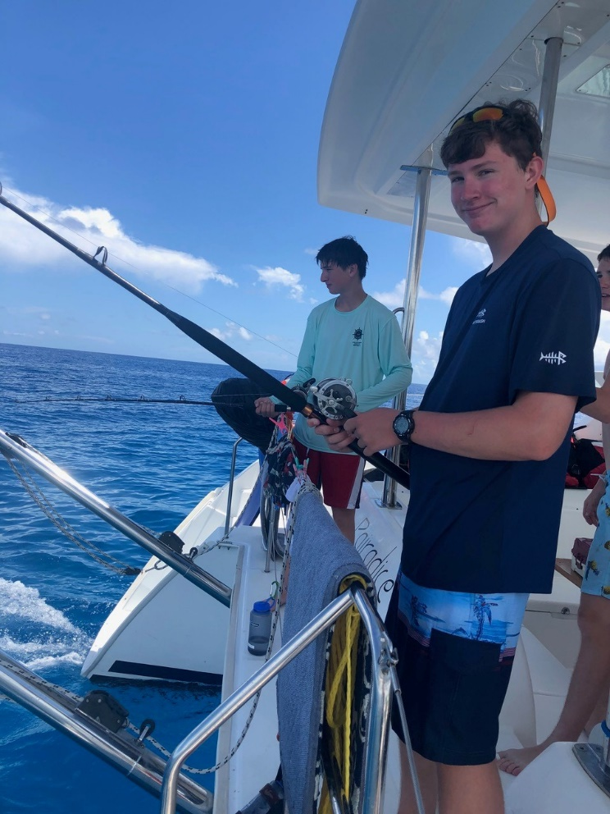
FAQ’s
Are we allowed to fish while on board?
Yes, Fishing poles and gear will be provided. The boat has a
fishing license that will cover everyone.
Are we able to catch lobster?
Using snorkeling equipment only and as long as they are in
season.
Will we have any breaks from the boat?
No. Once you depart Sea Base the boat will not return to any
port prior to it’s return to Sea Base.

Slide 30

FAQ’s
How much room do I have for clothing?
All your item (except bedding and scuba equipment) must fit into a 24 inch duffel bag
provided by Sea Base.
Where will we sleep while aboard the boat?
Most participants choose to sleep on deck, but bunks are available. Please bring a
pad incase you choose to sleep on deck. There is not enough room for hammocks.
What duties will we have while on board?
Preparing meals, cleaning the boat, raising and lowering sails, anchor watch and
other duties assigned by the captain.

Slide 31

FAQ’s
Recommendations on What to Bring
1 Long sleeve shirt • Water bottle
1 Short sleeve shirt • 1 Sleeping cover
Wide brimmed hat • Lightweight sleeping pad
Polarized sunglasses • 2 towels
Reef Safe sunscreen • Water Resistant watch
2 pair of shorts (1 swim trunks, 1 regular) • Toiletry kit
Light pants • Flashlight
3 Pairs of socks (1 being neoprene swim socks) • Camera
2 Pairs of shoes (1 athletic, 1 sandals) • Insect repellent
Light rain jacket • Dive logbook and certification card
Spending money ($100-$150) ● Mask and Snorkel

Slide 32
FAQ’s
What NOT to Bring
Spear guns
Dive knives
Firearms
Fireworks
Aerosol sunscreen or bug spray
Deck shoes
Metal or aluminum water bottles
Hammocks

Slide 33
Contact Details
Florida Sea Base Main phone 305-664-4173
FAX 305-664-2039
Scuba Director – Joe Angelo 305-664-5625
joe.angelo@scouting.org
Program Office Manager-Natacha Angelo 305-664-5627
natacha.angelo2@scouting.org
Registration Information – Andrea Watts 305-664-5616
andrea.watts@scouting.org
Assistant Manager – Tim Stanfill 305-664-5614
tim.stanfill@scouting.org

